Slide 1
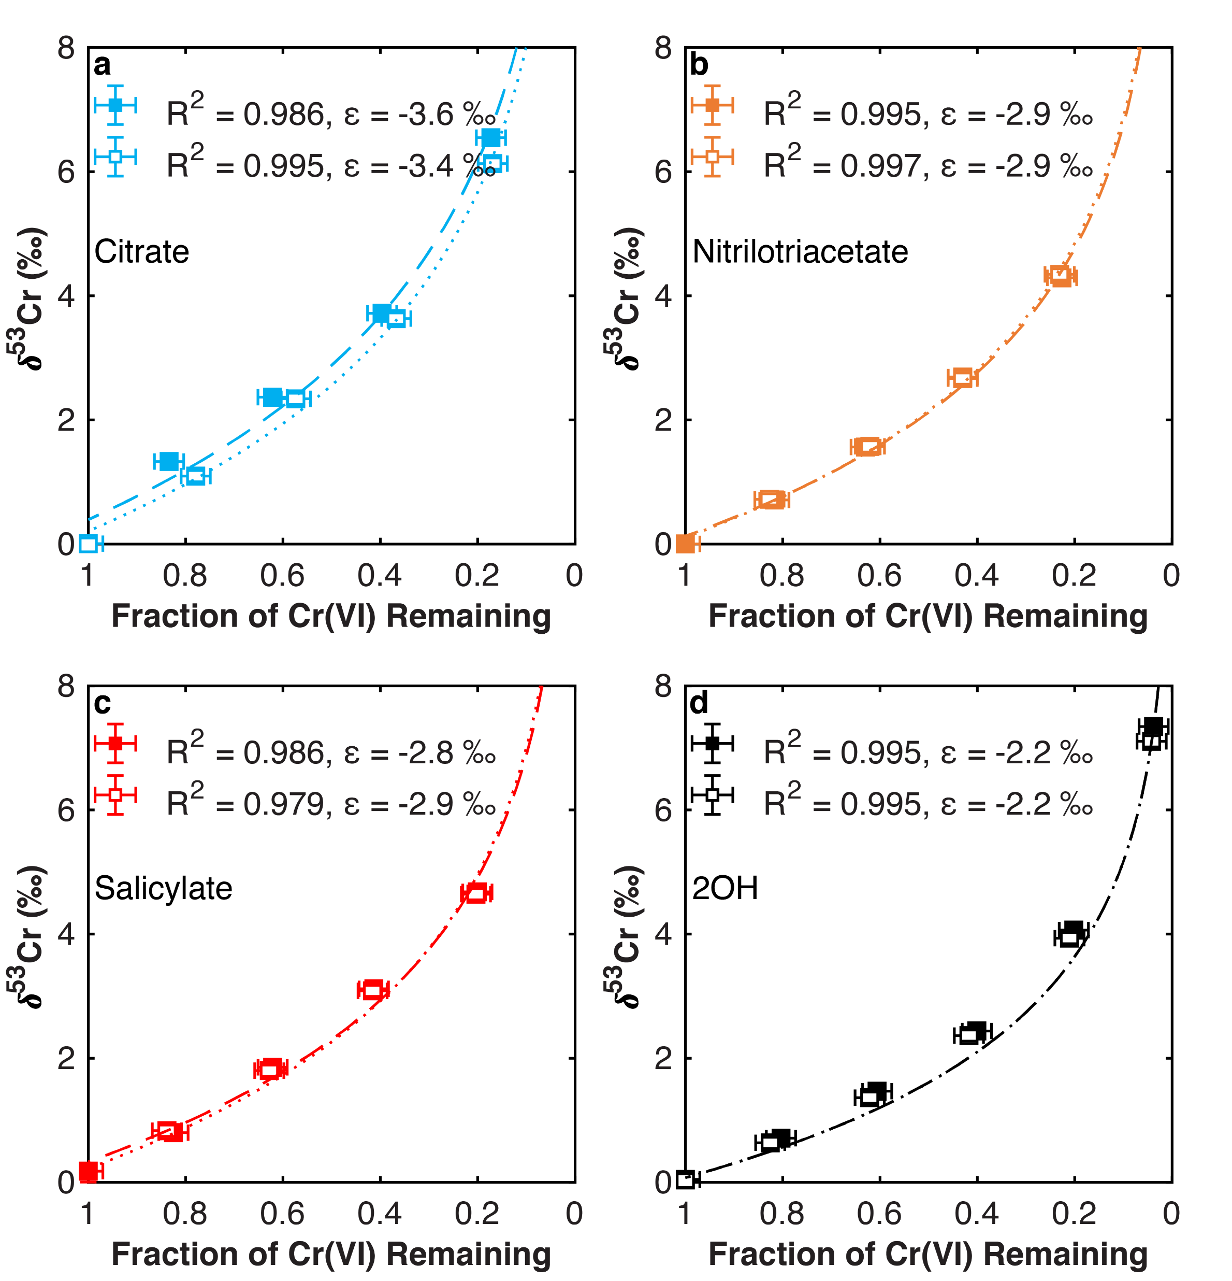
Joe-Wong et al.
Thermodynamic controls on redox-driven kinetic stable isotope fractionation
Figure 1 Isotope fractionation during Cr(VI) reduction by various aqueous Fe(II) species. Filled and open symbols in each plot show duplicate reactors. Rayleigh curves based on linear best fits are plotted as dashed lines (filled symbols) and dotted lines (open symbols). Vertical error bars (2 s.d.) are smaller than the symbols.
© 2019 The Authors
Published by the European Association of Geochemistry
under Creative Commons License CC BY-NC-ND.
Joe-Wong et al. (2019) Geochem. Persp. Let. 10, 20-25 | doi: 10.7185/geochemlet.1909
Notes:
Figure 1 Isotope fractionation during Cr(VI) reduction by various aqueous Fe(II) species. Filled and open symbols in each plot show duplicate reactors. Rayleigh curves based on linear best fits are plotted as dashed lines (filled symbols) and dotted lines (open symbols). Vertical error bars (2 s.d.) are smaller than the symbols.

