Slide 1
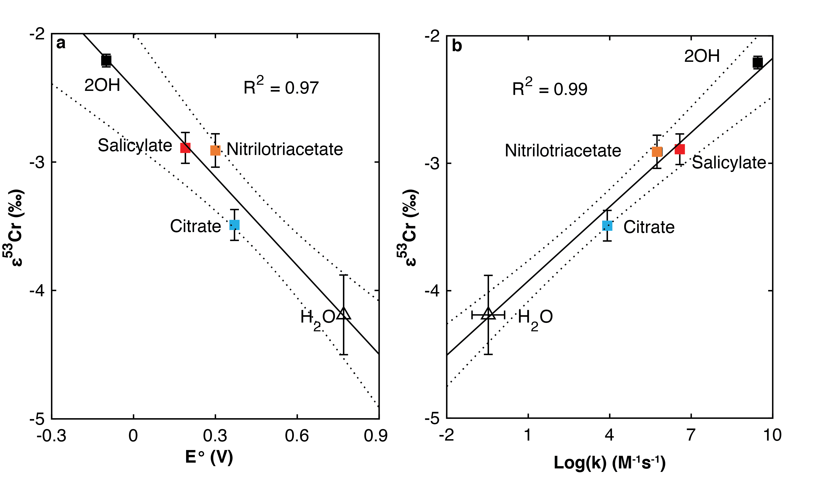
Joe-Wong et al.
Thermodynamic controls on redox-driven kinetic stable isotope fractionation
Figure 2 Linear relationships of kinetic isotope fractionation factor for Cr(VI) reduction with (a) the Fe(II)-Fe(III) standard reduction potential and (b) rate constants. Solid line shows weighted linear regression, and dotted lines show 95 % confidence interval. Each symbol shows the average fractionation factor calculated for replicate experiments. Error bars are 2 s.d. The fractionation factor for Cr(VI) reduction by Fe(H₂O)₆²⁺ is taken from Kitchen et al. (2012), and the rate constants are taken from Buerge and Hug (1997, 1998).
© 2019 The Authors
Published by the European Association of Geochemistry
under Creative Commons License CC BY-NC-ND.
Joe-Wong et al. (2019) Geochem. Persp. Let. 10, 20-25 | doi: 10.7185/geochemlet.1909
Notes:
Figure 2 Linear relationships of kinetic isotope fractionation factor for Cr(VI) reduction with (a) the Fe(II)-Fe(III) standard reduction potential and (b) rate constants. Solid line shows weighted linear regression, and dotted lines show 95 % confidence interval. Each symbol shows the average fractionation factor calculated for replicate experiments. Error bars are 2 s.d. The fractionation factor for Cr(VI) reduction by Fe(H₂O)₆²⁺ is taken from Kitchen et al. (2012), and the rate constants are taken from Buerge and Hug (1997, 1998).

