Slide 1
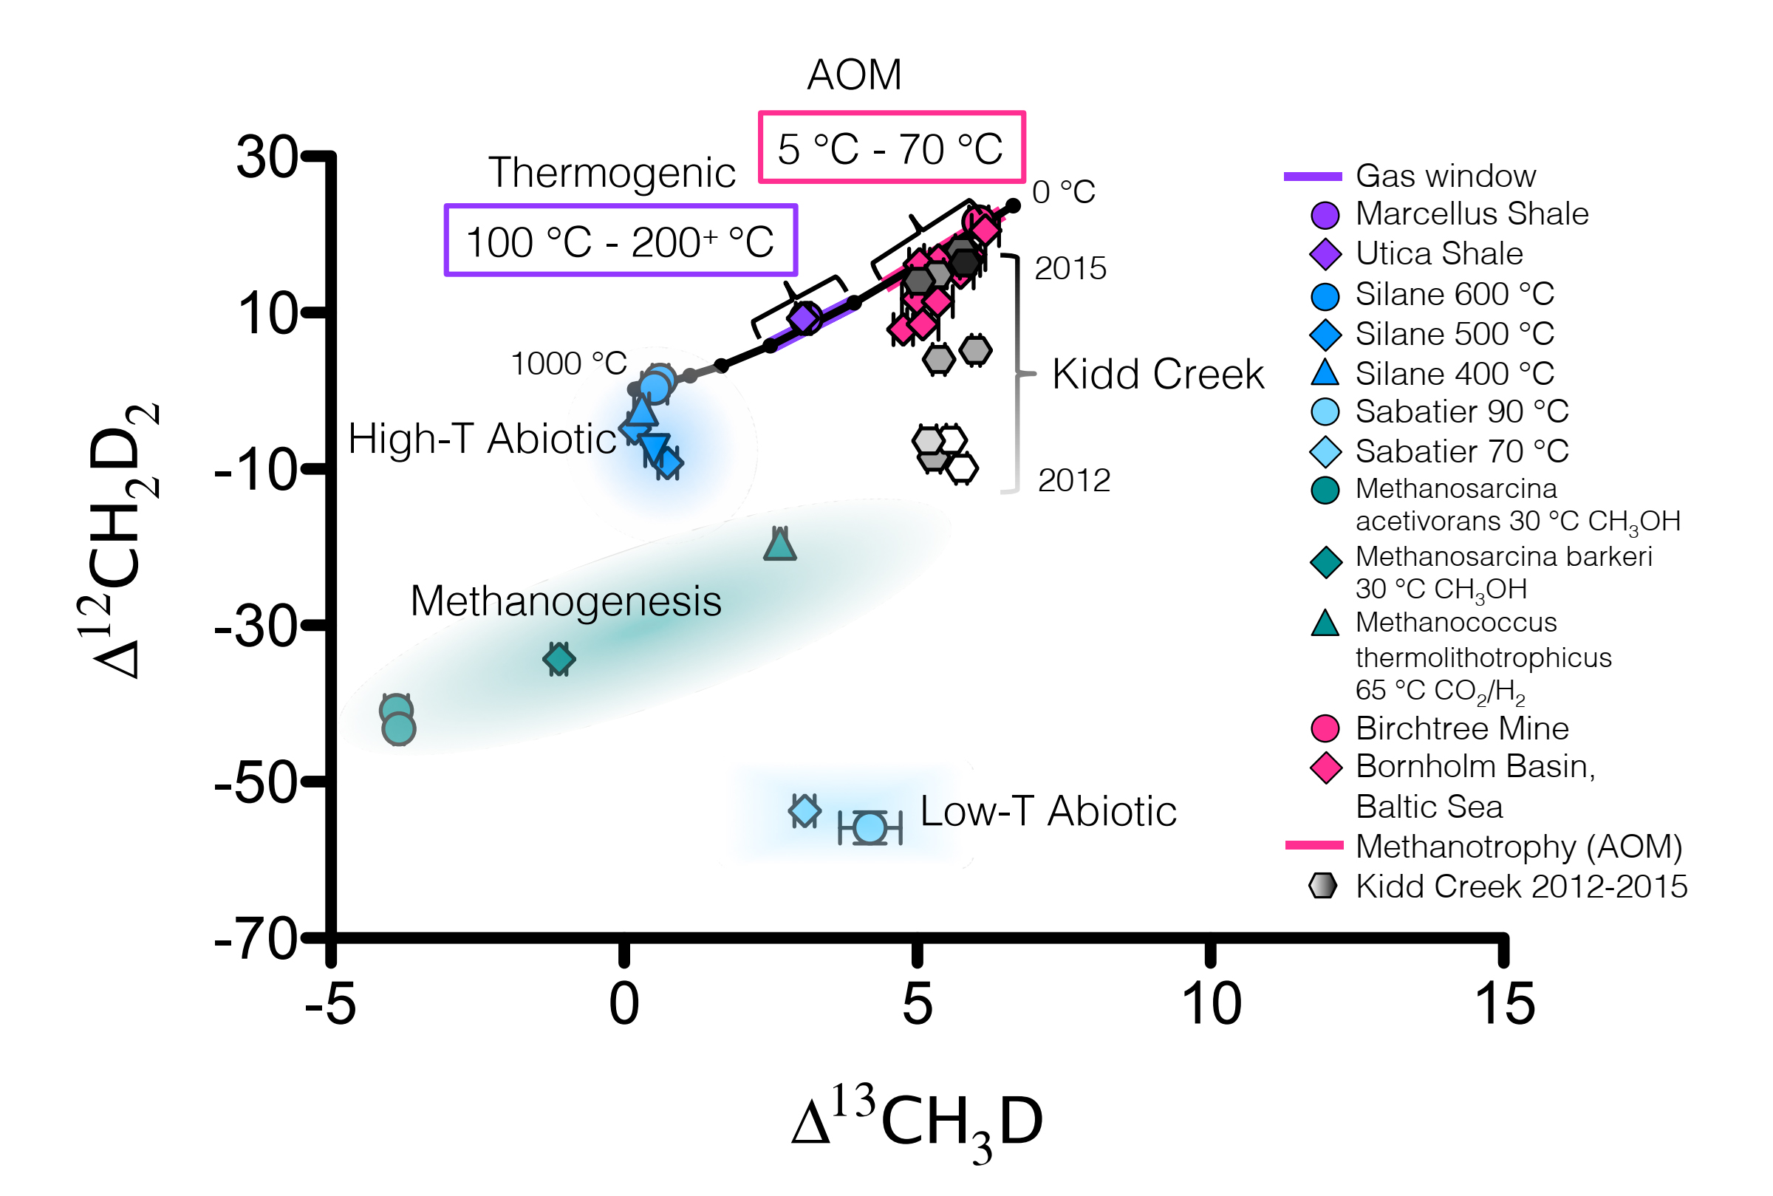
Ash et al.
Exchange catalysis during anaerobic methanotrophy revealed by ¹²CH₂D₂ and ¹³CH₃D in methane
Figure 3 Δ¹²CH₂D₂ is plotted versus Δ¹³CH₃D. The solid black line represents theoretical thermodynamic equilibrium abundances (with dots representing 100 °C increments from 0-1000 °C). Methane produced by thermogenesis, high temperature abiotic reactions, microbial methanogenesis and low temperature abiotic reactions inhabit unique zones in double isotopologue space. AOM, equilibrating through exchange catalysis during enzymatic back reaction, also inhibits a unique zone: low temperature intra-species thermodynamic equilibrium. Bornholm Basin data (magenta diamonds) span between the methanogenesis and AOM zones, while data from Kidd Creek Mine (black to white symbols) (Young et al., 2017) span from the abiotic to AOM zone. See Supplementary Information for additional sample description.
© 2019 The Authors
Published by the European Association of Geochemistry
under Creative Commons License CC BY-NC-ND.
Ash et al. (2019) Geochem. Persp. Let. 10, 26-30 | doi: 10.7185/geochemlet.1910
Notes:
Figure 3 Δ¹²CH₂D₂ is plotted versus Δ¹³CH₃D. The solid black line represents theoretical thermodynamic equilibrium abundances (with dots representing 100 °C increments from 0-1000 °C). Methane produced by thermogenesis, high temperature abiotic reactions, microbial methanogenesis and low temperature abiotic reactions inhabit unique zones in double isotopologue space. AOM, equilibrating through exchange catalysis during enzymatic back reaction, also inhibits a unique zone: low temperature intra-species thermodynamic equilibrium. Bornholm Basin data (magenta diamonds) span between the methanogenesis and AOM zones, while data from Kidd Creek Mine (black to white symbols) (Young et al., 2017) span from the abiotic to AOM zone. See Supplementary Information for additional sample description.

