Slide 1
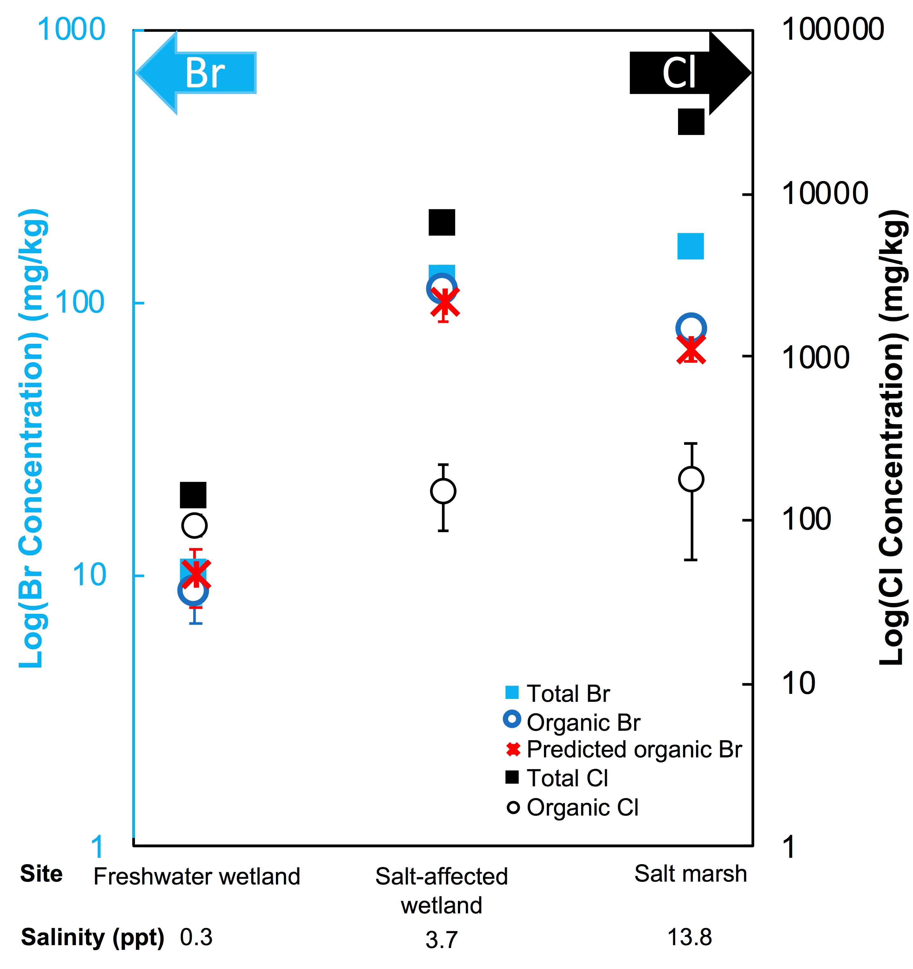
Joe-Wong et al.
Sea level rise produces abundant organobromines in salt-affected coastal wetlands
Figure 2 The concentration and speciation of Br (left, blue y axis) and Cl (right, black y axis) in sediments as a function of salinity (x axis) in Winyah Bay, South Carolina. All concentrations are the average of samples from different depths and two cores. Vertical error bars show the standard error and are in some cases smaller than the points.
© 2019 The Authors
Published by the European Association of Geochemistry
under Creative Commons License CC BY-NC-ND.
Joe-Wong et al. (2019) Geochem. Persp. Let. 10, 31-35 | doi: 10.7185/geochemlet.1911
Notes:
Figure 2 The concentration and speciation of Br (left, blue y axis) and Cl (right, black y axis) in sediments as a function of salinity (x axis) in Winyah Bay, South Carolina. All concentrations are the average of samples from different depths and two cores. Vertical error bars show the standard error and are in some cases smaller than the points.

