Slide 1
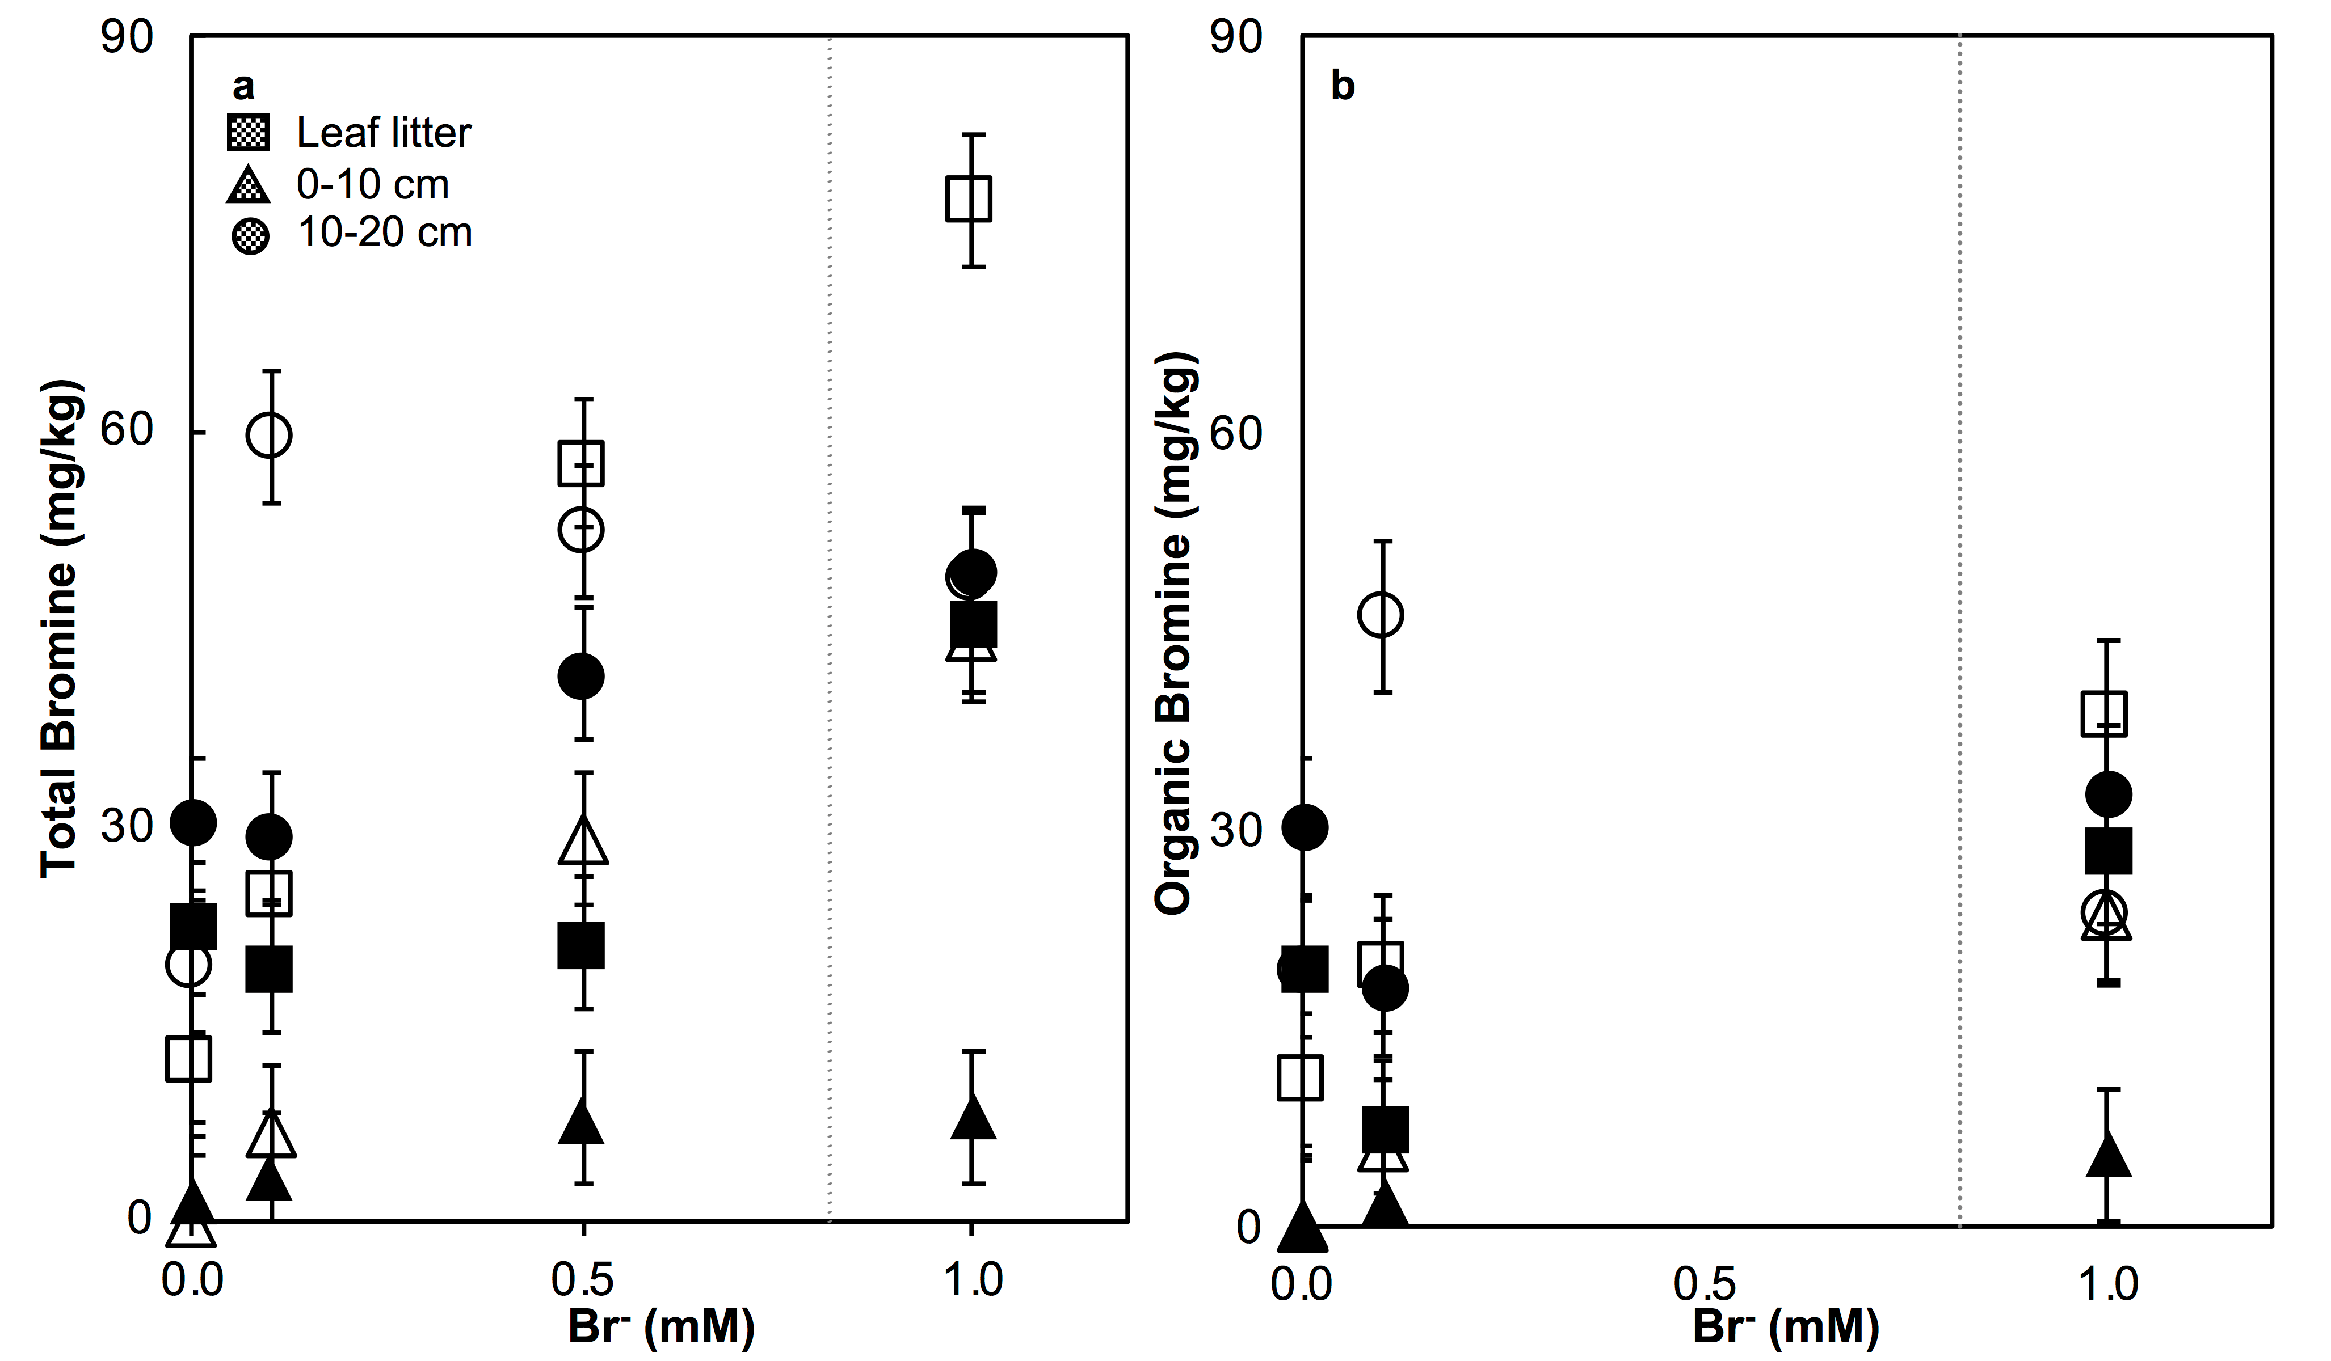
Joe-Wong et al.
Sea level rise produces abundant organobromines in salt-affected coastal wetlands
Figure 3 (a) Total Br and (b) organically bound Br produced in Br⁻-reacted soil samples as a function of increasing aqueous Br⁻ concentrations. Filled shapes (●) represent saturated conditions (mimicking salt marsh conditions) and open shapes (○) represent wet/dry conditions (mimicking salt-affected wetland conditions). Vertical gray dotted line shows Br⁻ concentration in seawater in both panels. Error bars are based on replicate XRF analyses (total Br and organic Br) and error from XANES linear combination fitting for organic Br.
© 2019 The Authors
Published by the European Association of Geochemistry
under Creative Commons License CC BY-NC-ND.
Joe-Wong et al. (2019) Geochem. Persp. Let. 10, 31-35 | doi: 10.7185/geochemlet.1911
Notes:
Figure 3 (a) Total Br and (b) organically bound Br produced in Br⁻-reacted soil samples as a function of increasing aqueous Br⁻ concentrations. Filled shapes (●) represent saturated conditions (mimicking salt marsh conditions) and open shapes (○) represent wet/dry conditions (mimicking salt-affected wetland conditions). Vertical gray dotted line shows Br⁻ concentration in seawater in both panels. Error bars are based on replicate XRF analyses (total Br and organic Br) and error from XANES linear combination fitting for organic Br.

