Slide 1
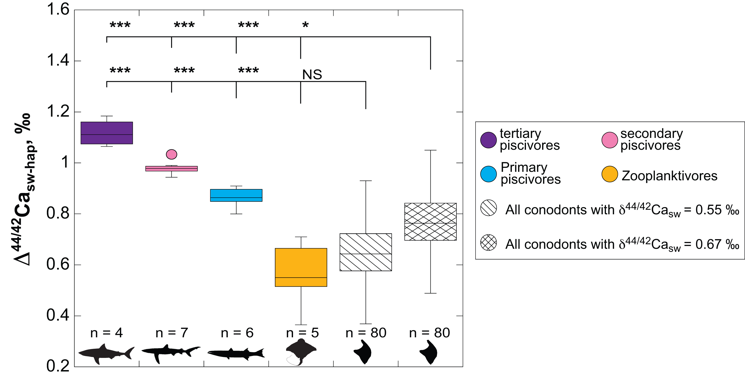
Balter et al.
Calcium stable isotopes place Devonian conodonts as first level consumers
Figure 2 Ca isotopic offset between seawater and hap of modern elasmobranchs compared to that of conodonts (Δ^{44/42}Ca_{sw-hap}) measured in the study. Modern elasmobranch data are from Martin et al. (2015). The Δ^{44/42}Ca_{sw-hap} offset is calculated with two δ^{44/42}Ca_{sw} values, 0.55 ‰ (diagonal lines) and 0.67 ‰ (diagonal cross hatch) corresponding to the range given by Farkaš et al. (2007; Fig. S-3). Boxplots delimit 5, 25, 50, 75 and 95 % percentiles. Depending on the δ^{44/42}Ca_{sw} value, statistics…
© 2019 The Authors
Published by the European Association of Geochemistry
under Creative Commons License CC BY-NC-ND.
Balter et al. (2019) Geochem. Persp. Let. 10, 36-39 | doi: 10.7185/geochemlet.1912
Notes:
Figure 2 Ca isotopic offset between seawater and hap of modern elasmobranchs compared to that of conodonts (Δ^{44/42}Ca_{sw-hap}) measured in the study. Modern elasmobranch data are from Martin et al. (2015). The Δ^{44/42}Ca_{sw-hap} offset is calculated with two δ^{44/42}Ca_{sw} values, 0.55 ‰ (diagonal lines) and 0.67 ‰ (diagonal cross hatch) corresponding to the range given by Farkaš et al. (2007; Fig. S-3). Boxplots delimit 5, 25, 50, 75 and 95 % percentiles. Depending on the δ^{44/42}Ca_{sw} value, statistics show that conodonts and zooplanktivores have similar δ^{44/42}Ca values. Under the null hypothesis that there is no difference in the distribution of two groups of δ^{44/42}Ca values, the p value of Student's t-tests provides the smallest level of significance at which null hypothesis would be rejected (NS, non-significant p value; *p = 0.01–0.05; **p = 0.001–0.01; and ***p < 0.001).

