Slide 1
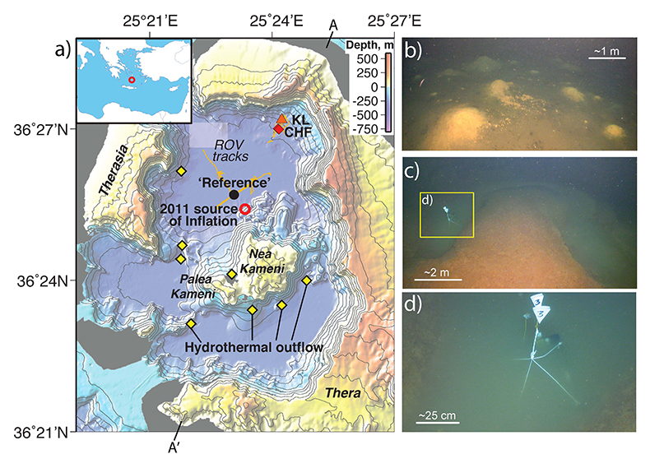
Moreira et al.
New insights into the plumbing system of Santorini using helium and carbon isotopes
Figure 1 (a) Synthetic topographic map (Nomikou et al., 2014) showing the position of hydrothermal outflow areas within the Santorin caldera. Two samples were collected at the ‘Reference’ site, which corresponds to near-bottom water away from hydrothermal sources and at the bottom of the northern basin of the caldera. The other samples were collected at the caldera hydrothermal field (CHF)…
© 2019 The Authors
Published by the European Association of Geochemistry
under Creative Commons License CC BY-NC-ND.
Moreira et al. (2019) Geochem. Persp. Let. 10, 46-50 | doi: 10.7185/geochemlet.1914
Notes:
Figure 1 (a) Synthetic topographic map (Nomikou et al., 2014) showing the position of hydrothermal outflow areas within the Santorin caldera. Two samples were collected at the ‘Reference’ site, which corresponds to near-bottom water away from hydrothermal sources and at the bottom of the northern basin of the caldera. The other samples were collected at the caldera hydrothermal field (CHF), which shows mounds of bacterial mat (b), and at the Kallisti Limnes (KL), which shows sub-sea pools with CO₂-rich fluids (Camilli et al., 2015) (c and d). CHF and other hydrothermal areas throughout the caldera where observed in 2006 (Sigurdsson et al., 2006). The red open circle corresponds to the Mogi source model associated with the 2011 inflation event (Newman et al., 2012). A and A’ indicate the ends of bathymetric profile in Figure 3.

