Slide 1
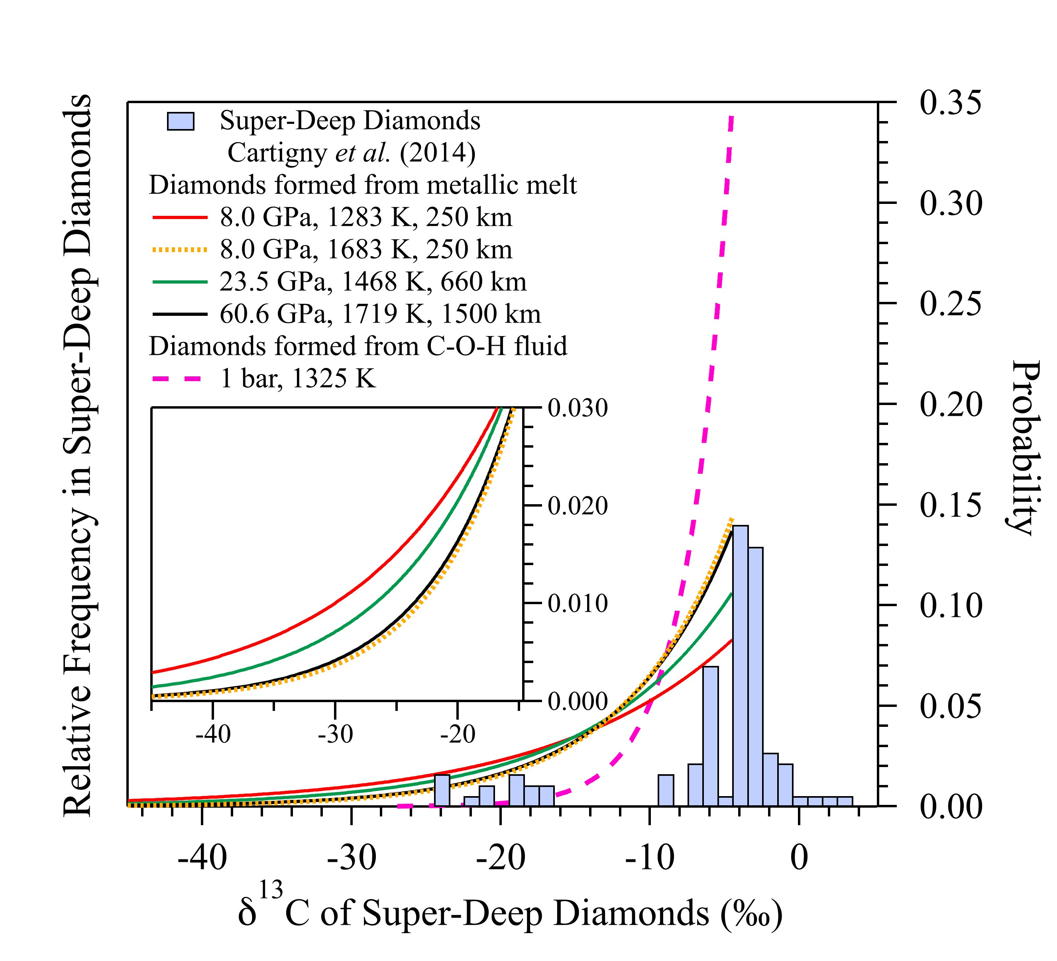
Liu et al.
Carbon isotopic signatures of super-deep diamonds mediated by iron redox chemistry
Figure 2 Comparison of the histogram for δ¹³C of super-deep diamonds (left axis) and the probability density functions (PDFs, right axis) of δ¹³C^{Dia} derived from metallic melt for different P-T conditions. The red, green and black solid curves are calculated PDFs by using Δ¹³C^{Dia-FeC melt} at 250 km, 660 km and 1500 km depths along a cold slab geotherm (Yang et al., 2017), respectively. The yellow dotted curve is calculated by using Δ¹³C^{Dia-FeC melt} at 250 km along the modern mantle geotherm (Yang et al., 2017), which may be similar to the Archean mantle geotherm (Santosh et al., 2010). The pink dashed curve is for diamonds forming from C-H-O fluids, which is calculated using the largest reported value of Δ¹³C^{Dia-COH} (-2.9 ‰) (Cartigny et al., 2014). The inset figure shows the negative tailings of these three PDFs. δ¹³C data of super-deep diamonds are from Cartigny et al. (2014).
© 2019 The Authors
Published by the European Association of Geochemistry
under Creative Commons License CC BY-NC-ND.
Liu et al. (2019) Geochem. Persp. Let. 10, 51-55 | doi: 10.7185/geochemlet.1915
Notes:
Figure 2 Comparison of the histogram for δ¹³C of super-deep diamonds (left axis) and the probability density functions (PDFs, right axis) of δ¹³C^{Dia} derived from metallic melt for different P-T conditions. The red, green and black solid curves are calculated PDFs by using Δ¹³C^{Dia-FeC melt} at 250 km, 660 km and 1500 km depths along a cold slab geotherm (Yang et al., 2017), respectively. The yellow dotted curve is calculated by using Δ¹³C^{Dia-FeC melt} at 250 km along the modern mantle geotherm (Yang et al., 2017), which may be similar to the Archean mantle geotherm (Santosh et al., 2010). The pink dashed curve is for diamonds forming from C-H-O fluids, which is calculated using the largest reported value of Δ¹³C^{Dia-COH} (-2.9 ‰) (Cartigny et al., 2014). The inset figure shows the negative tailings of these three PDFs. δ¹³C data of super-deep diamonds are from Cartigny et al. (2014).

