Slide 1
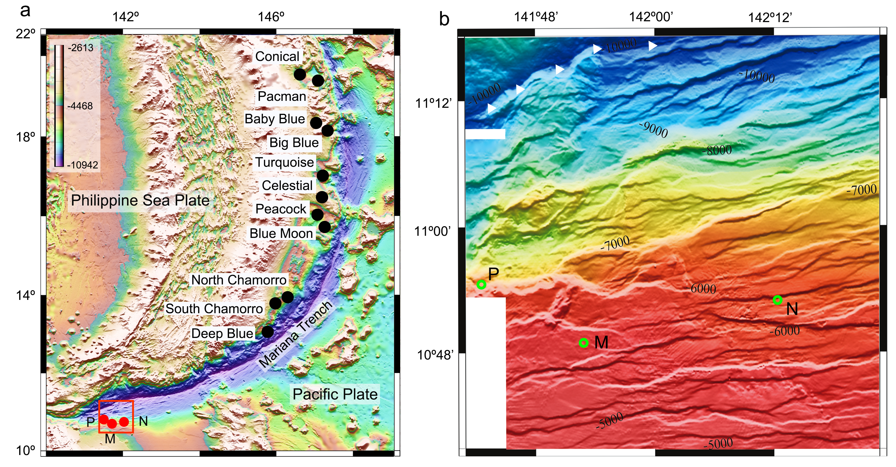
Du et al.
Fluid discharge linked to bending of the incoming plate at the Mariana subduction zone
Figure 1 (a) Location of the newly discovered fluid discharge field at site M and two pockmarks at sites N and P (red dots) on the incoming plate of Mariana trench. (b) Enlarged shaded-relief map of red box in (a). The sites M, N and P (green circles) are situated on the base of the slopes of bending-related faults that have been extensively developed and pervasively cross the entire trench slope of the incoming plate in response to plate flexure. White triangles show the axis of the southern Mariana trench. The known serpentinite mud volcanoes (black dots in (a)) are exclusively located on the overriding plate of Mariana trench. White bars in (b) show blank areas where no multi-beam bathymetric data are available.
© 2019 The Authors
Published by the European Association of Geochemistry
under Creative Commons License CC BY-NC-ND.
Du et al. (2019) Geochem. Persp. Let. 11, 1-5 | doi: 10.7185/geochemlet.1916
Notes:
Figure 1 (a) Location of the newly discovered fluid discharge field at site M and two pockmarks at sites N and P (red dots) on the incoming plate of Mariana trench. (b) Enlarged shaded-relief map of red box in (a). The sites M, N and P (green circles) are situated on the base of the slopes of bending-related faults that have been extensively developed and pervasively cross the entire trench slope of the incoming plate in response to plate flexure. White triangles show the axis of the southern Mariana trench. The known serpentinite mud volcanoes (black dots in (a)) are exclusively located on the overriding plate of Mariana trench. White bars in (b) show blank areas where no multi-beam bathymetric data are available.

