Slide 1
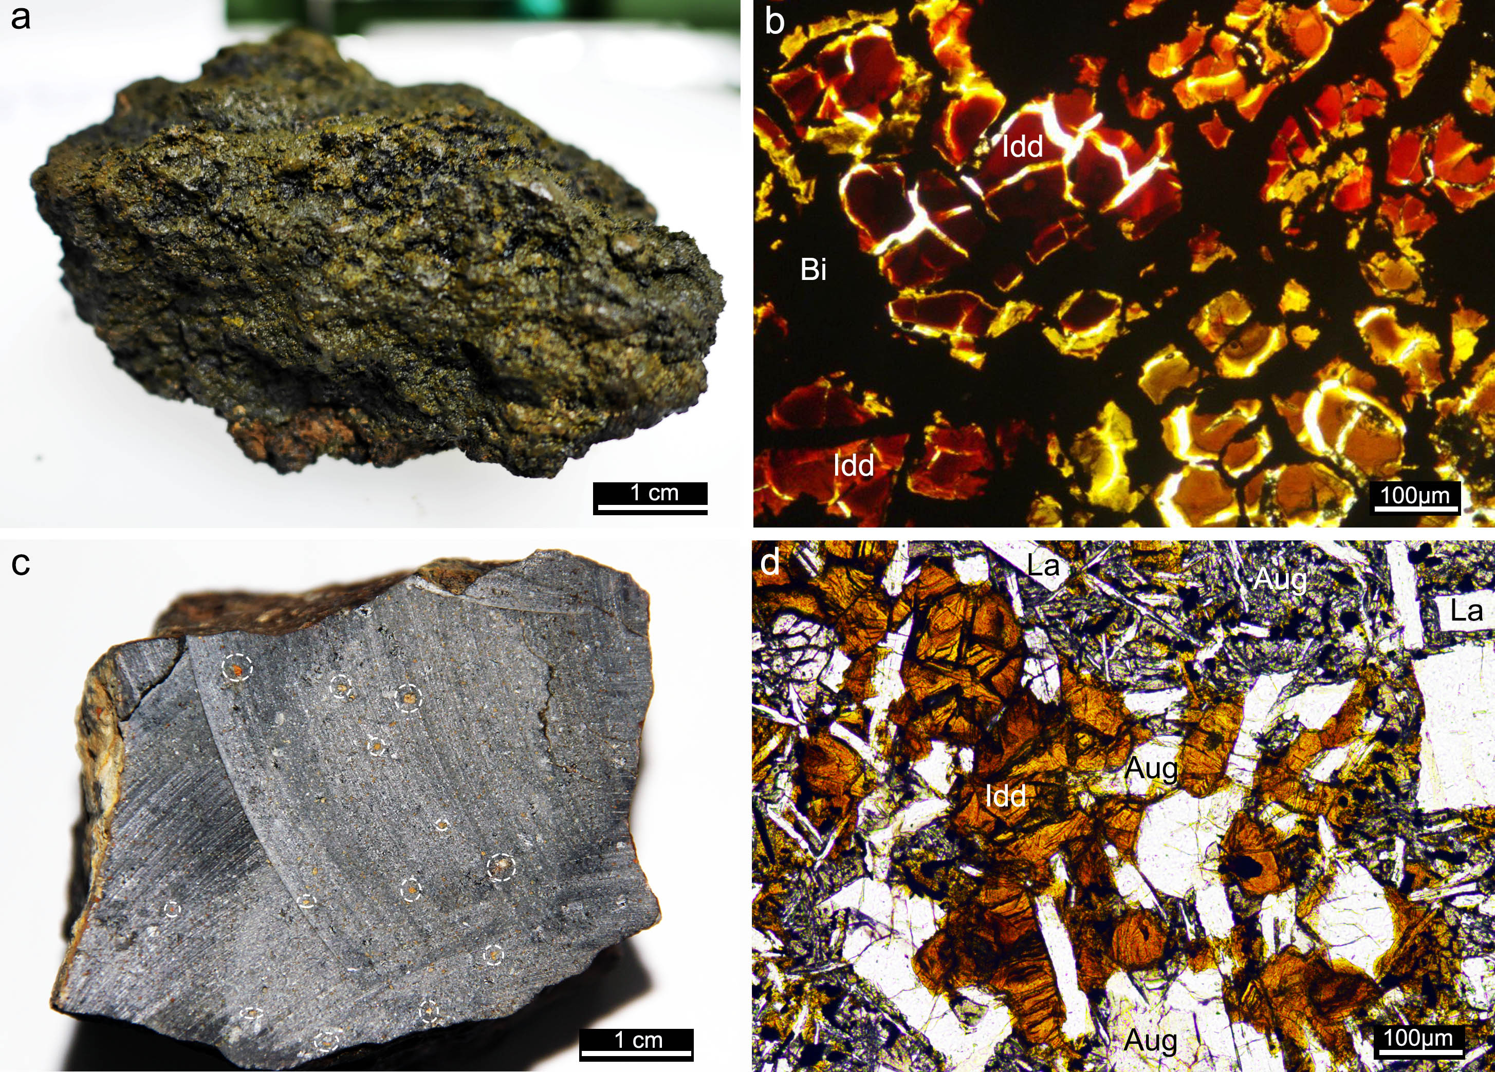
Du et al.
Fluid discharge linked to bending of the incoming plate at the Mariana subduction zone
Figure 3 Highly altered and partly altered basement rocks associated with fluid discharge points. (a) A dark-green, fragile and highly altered basement rock (#JL115-Rock-11) recovered from site M. (b) Image in plane polarised light showing that the rock in (a) exhibits a mesh-like structure composed of reddish iddingsite (Idd) and black birnessite (Bi). The latter probably precipitated from seawater along fractures of the altered rocks in the late stage. (c) A partly altered basement rock recovered from the vicinity of site M (#JL116-Rock-6). Dotted cycles point out reddish iddingsite in the basaltic host. (d) Image in plane polarised light showing that the rock in (c) is primarily composed of augite (Aug), labradorite (La) and a cluster of reddish iddingsite (Idd).
© 2019 The Authors
Published by the European Association of Geochemistry
under Creative Commons License CC BY-NC-ND.
Du et al. (2019) Geochem. Persp. Let. 11, 1-5 | doi: 10.7185/geochemlet.1916
Notes:
Figure 3 Highly altered and partly altered basement rocks associated with fluid discharge points. (a) A dark-green, fragile and highly altered basement rock (#JL115-Rock-11) recovered from site M. (b) Image in plane polarised light showing that the rock in (a) exhibits a mesh-like structure composed of reddish iddingsite (Idd) and black birnessite (Bi). The latter probably precipitated from seawater along fractures of the altered rocks in the late stage. (c) A partly altered basement rock recovered from the vicinity of site M (#JL116-Rock-6). Dotted cycles point out reddish iddingsite in the basaltic host. (d) Image in plane polarised light showing that the rock in (c) is primarily composed of augite (Aug), labradorite (La) and a cluster of reddish iddingsite (Idd).

