Slide 1
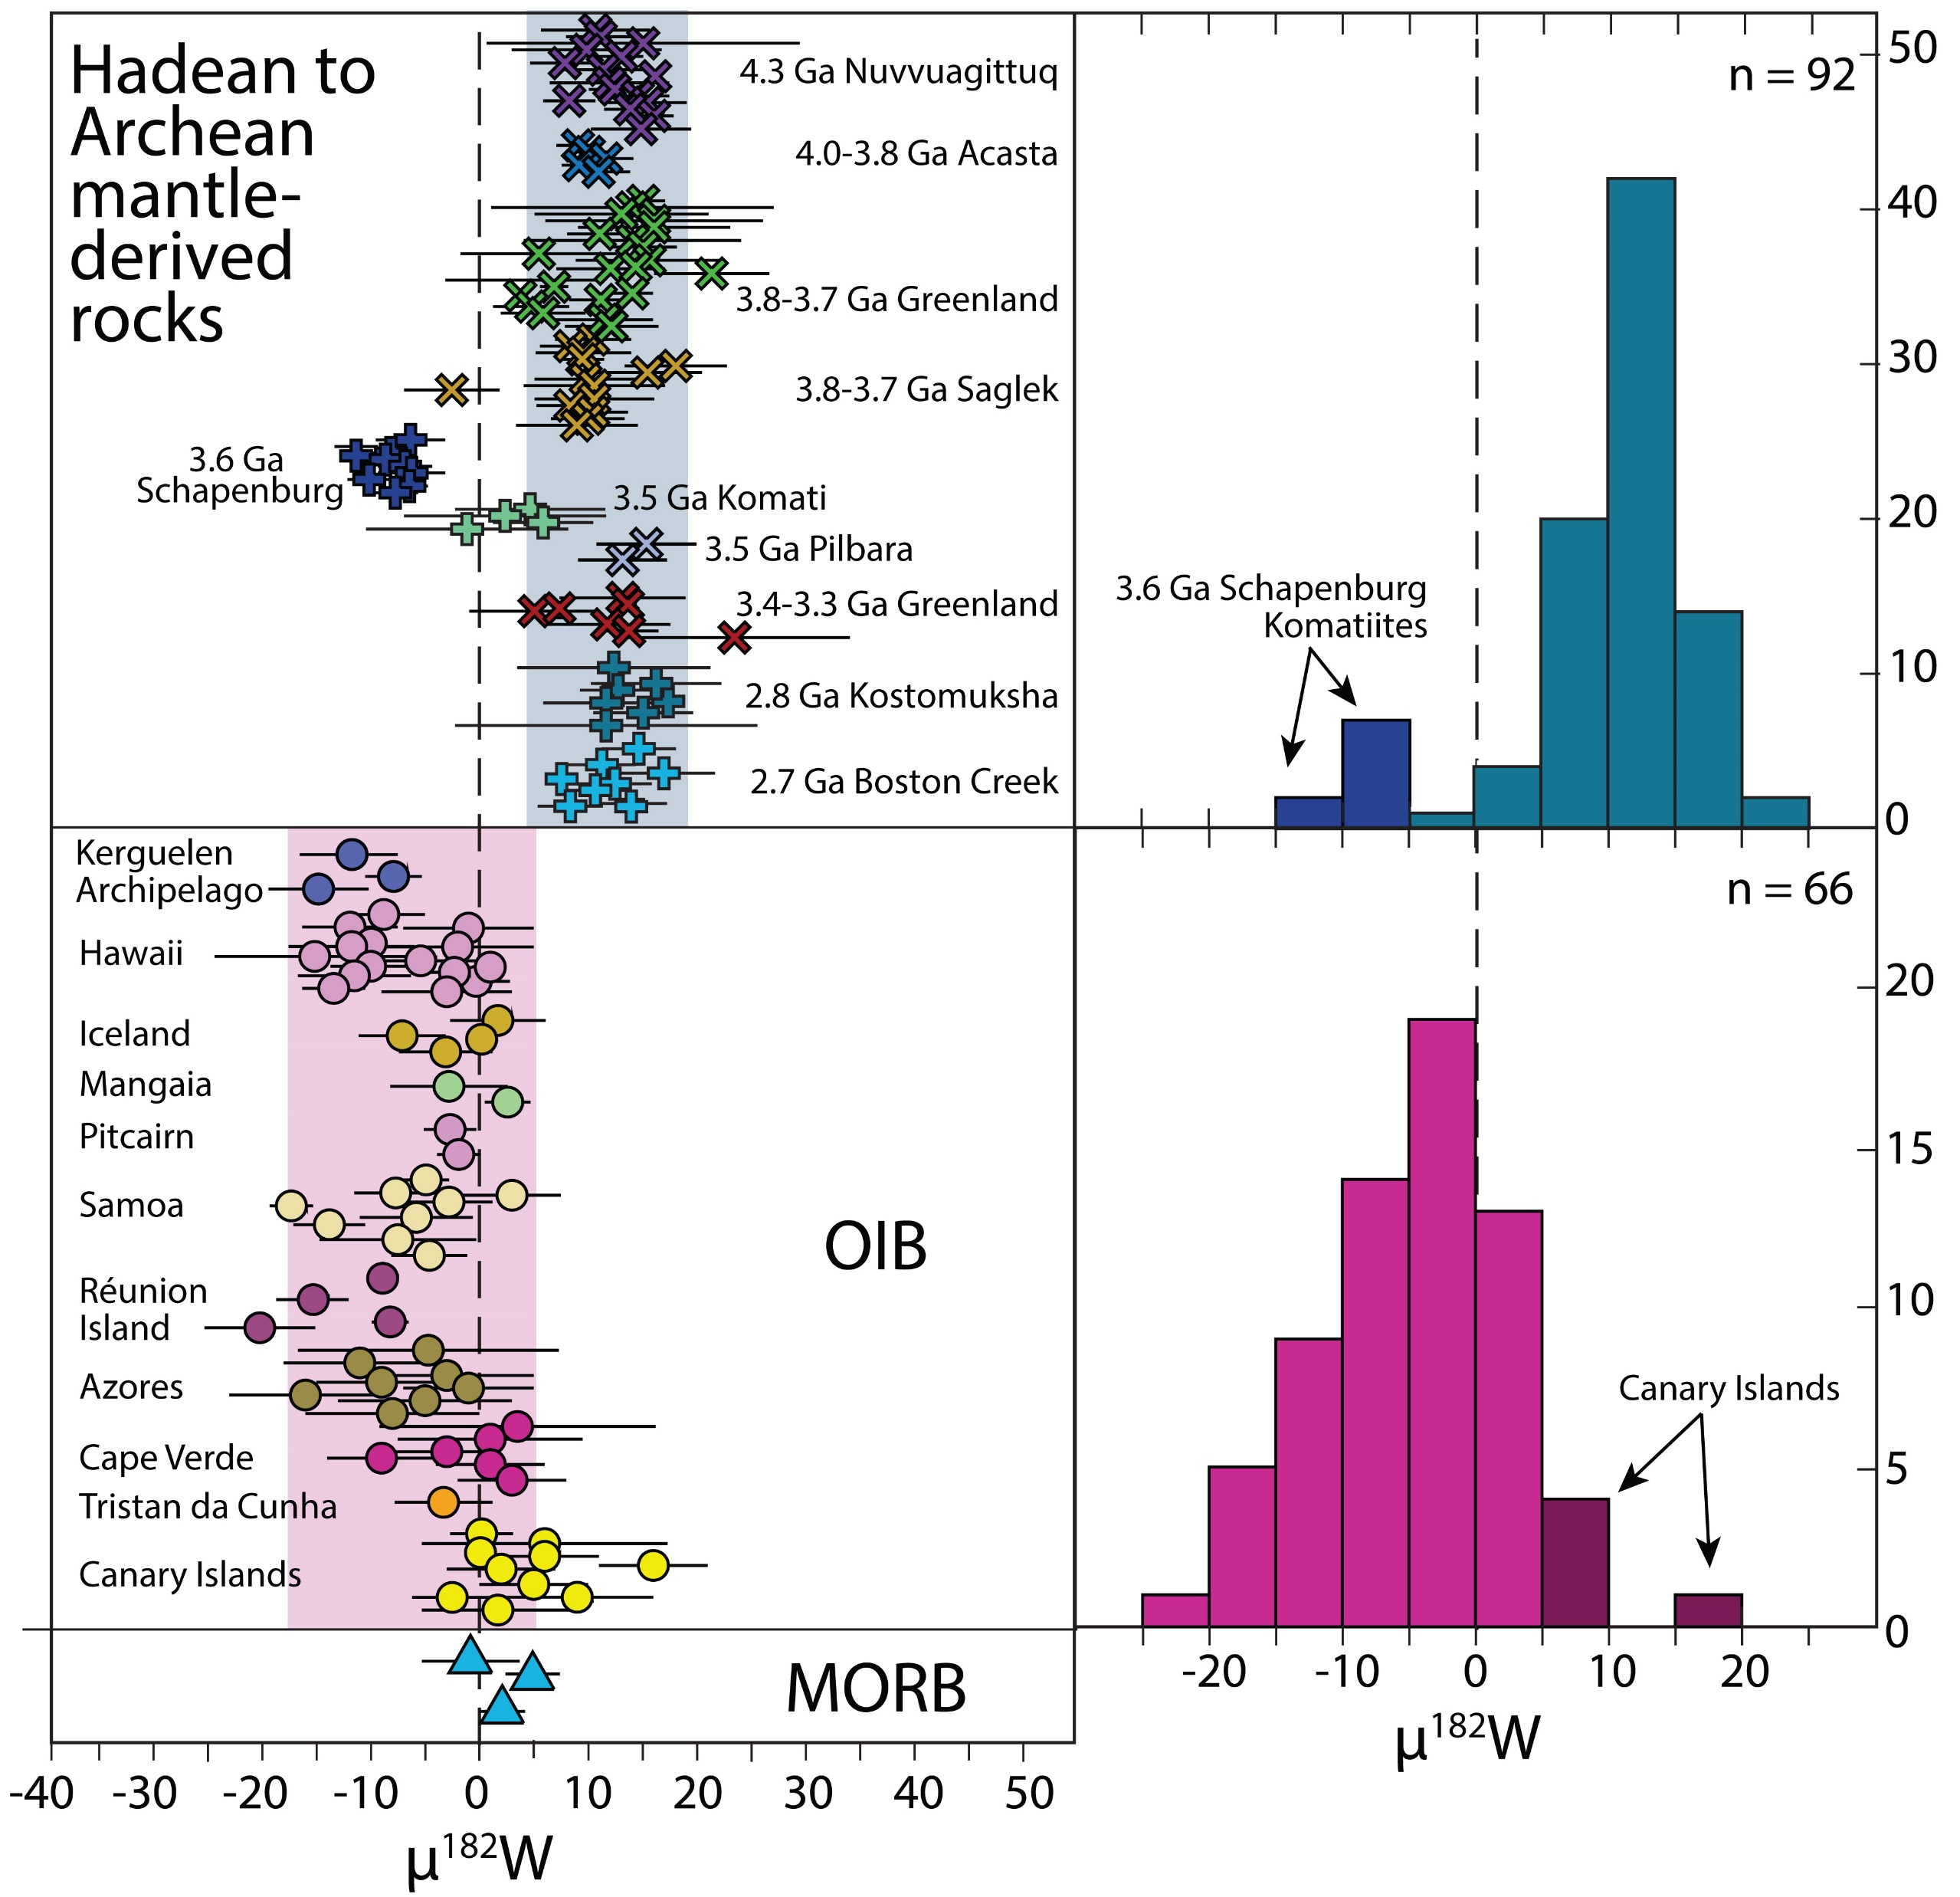
Rizo et al.
¹⁸²W evidence for core-mantle interaction in the source of mantle plumes
Figure 2 Compilation of all existing ¹⁸²W/¹⁸⁴W data shown as µ¹⁸²W values. Hadean and Archean mantle-derived rocks are organised in order of their age, with the oldest at the top and the youngest at the bottom. Shaded areas show the average µ¹⁸²W values ± 2 s.d. for Hadean-Archean and OIB samples. OIB: Ocean Island Basalts. MORB: Mid-Ocean Ridge Basalts. Data sources: Willbold et al., 2011, 2015; Touboul et al., 2012, 2014; Liu et al., 2016; Puchtel et al., 2016, 2018; Rizo et al., 2016a,b; Dale et al., 2017; Mundl et al., 2017; Kruijer and Kleine, 2018; Mei et al., 2018; Reimink et al., 2018; and this study.
© 2019 The Authors
Published by the European Association of Geochemistry
under Creative Commons License CC BY-NC-ND.
Rizo et al. (2019) Geochem. Persp. Let. 11, 6-11 | doi: 10.7185/geochemlet.1917
Notes:
Figure 2 Compilation of all existing ¹⁸²W/¹⁸⁴W data shown as µ¹⁸²W values. Hadean and Archean mantle-derived rocks are organised in order of their age, with the oldest at the top and the youngest at the bottom. Shaded areas show the average µ¹⁸²W values ± 2 s.d. for Hadean-Archean and OIB samples. OIB: Ocean Island Basalts. MORB: Mid-Ocean Ridge Basalts. Data sources: Willbold et al., 2011, 2015; Touboul et al., 2012, 2014; Liu et al., 2016; Puchtel et al., 2016, 2018; Rizo et al., 2016a,b; Dale et al., 2017; Mundl et al., 2017; Kruijer and Kleine, 2018; Mei et al., 2018; Reimink et al., 2018; and this study.

