Slide 1
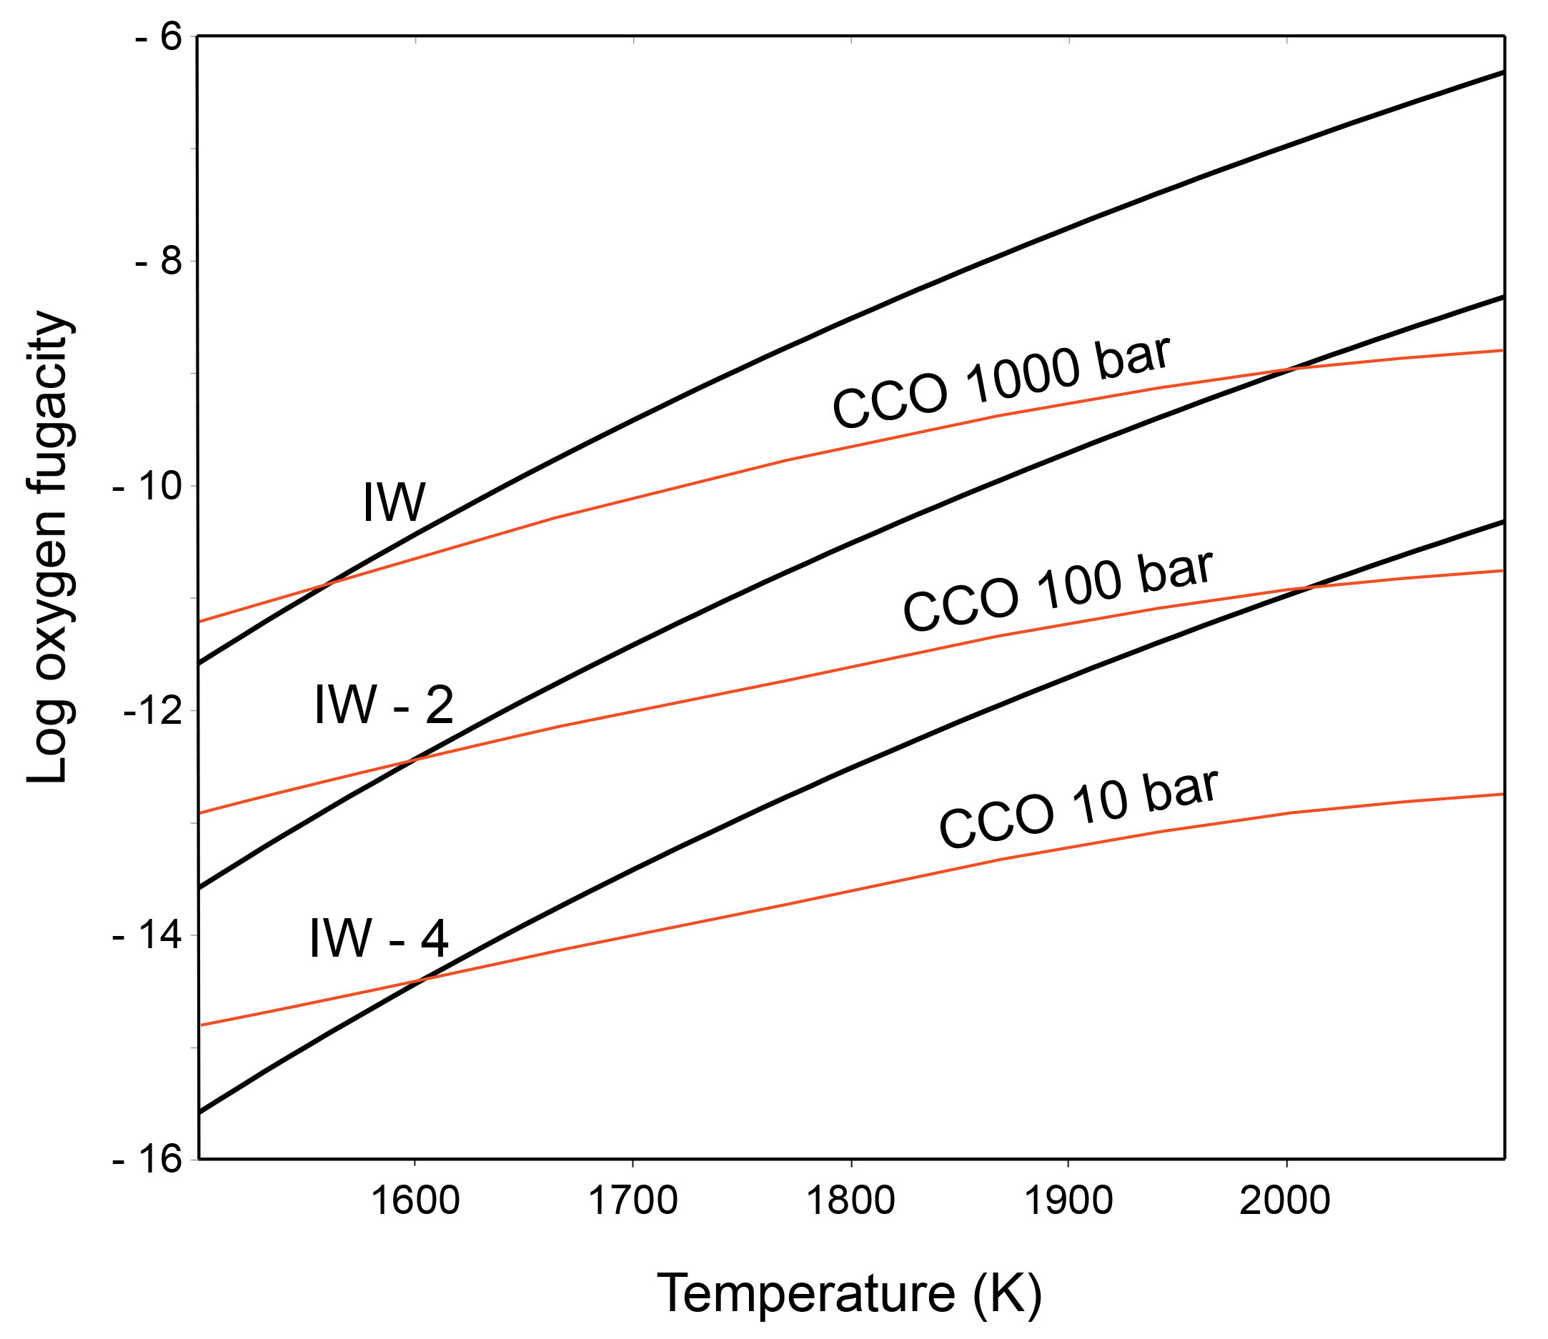
Keppler and Golabek
Graphite floatation on a magma ocean and the fate of carbon during core formation
Figure 1 Consequences of thermodynamic equilibrium between a magma ocean, graphite, and a primordial atmosphere. Shown are the curves for the oxygen fugacities of the iron-wustite (Fe-FeO) buffer (IW) and for the graphite–CO–CO₂ buffer (CCO) for different CO + CO₂ pressures (see Methods in Supplementary Information). Plausible oxygen fugacities of a magma ocean range from IW-2 to IW-5.5 (Rubie et al., 2011). The diagram shows that equilibrium between such a reducing magma ocean and graphite buffers the CO + CO₂ pressure in a primordial atmosphere to very low values.
© 2019 The Authors
Published by the European Association of Geochemistry
under Creative Commons License CC BY-NC-ND.
Keppler and Golabek (2019) Geochem. Persp. Let. 11, 12-17 | doi: 10.7185/geochemlet.1918
Notes:
Figure 1 Consequences of thermodynamic equilibrium between a magma ocean, graphite, and a primordial atmosphere. Shown are the curves for the oxygen fugacities of the iron-wustite (Fe-FeO) buffer (IW) and for the graphite–CO–CO₂ buffer (CCO) for different CO + CO₂ pressures (see Methods in Supplementary Information). Plausible oxygen fugacities of a magma ocean range from IW-2 to IW-5.5 (Rubie et al., 2011). The diagram shows that equilibrium between such a reducing magma ocean and graphite buffers the CO + CO₂ pressure in a primordial atmosphere to very low values.

