Slide 1
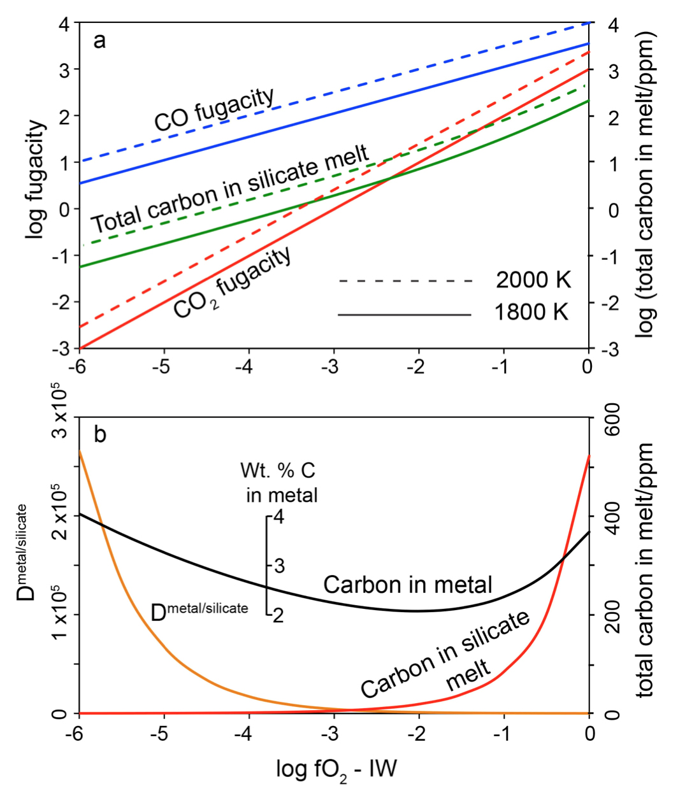
Keppler and Golabek
Graphite floatation on a magma ocean and the fate of carbon during core formation
Figure 3 Partitioning of carbon between atmosphere, silicate melt, and metal in the presence of graphite. (a) CO fugacity, CO₂ fugacity, and total carbon in a silicate melt in equilibrium with graphite for a temperature of 1800 and 2000 K at the surface of a magma ocean. (b) Carbon content in the silicate melt as expected from the equilibrium with graphite at 2000 K at the surface of a magma ocean, predicted metal/silicate melt partition coefficient of carbon inside the magma ocean (after Chi et al., 2014, NBO/T = 3, 2000 K and 3 GPa) and predicted carbon content of metal in equilibrium with the silicate melt. In the presence of hydrogen, methane could be an additional carbon species; however, as we show in the Supplementary Information, the effect of CH₄ on the behaviour of carbon is likely negligible.
© 2019 The Authors
Published by the European Association of Geochemistry
under Creative Commons License CC BY-NC-ND.
Keppler and Golabek (2019) Geochem. Persp. Let. 11, 12-17 | doi: 10.7185/geochemlet.1918
Notes:
Figure 3 Partitioning of carbon between atmosphere, silicate melt, and metal in the presence of graphite. (a) CO fugacity, CO₂ fugacity, and total carbon in a silicate melt in equilibrium with graphite for a temperature of 1800 and 2000 K at the surface of a magma ocean. (b) Carbon content in the silicate melt as expected from the equilibrium with graphite at 2000 K at the surface of a magma ocean, predicted metal/silicate melt partition coefficient of carbon inside the magma ocean (after Chi et al., 2014, NBO/T = 3, 2000 K and 3 GPa) and predicted carbon content of metal in equilibrium with the silicate melt. In the presence of hydrogen, methane could be an additional carbon species; however, as we show in the Supplementary Information, the effect of CH₄ on the behaviour of carbon is likely negligible.

