Slide 1
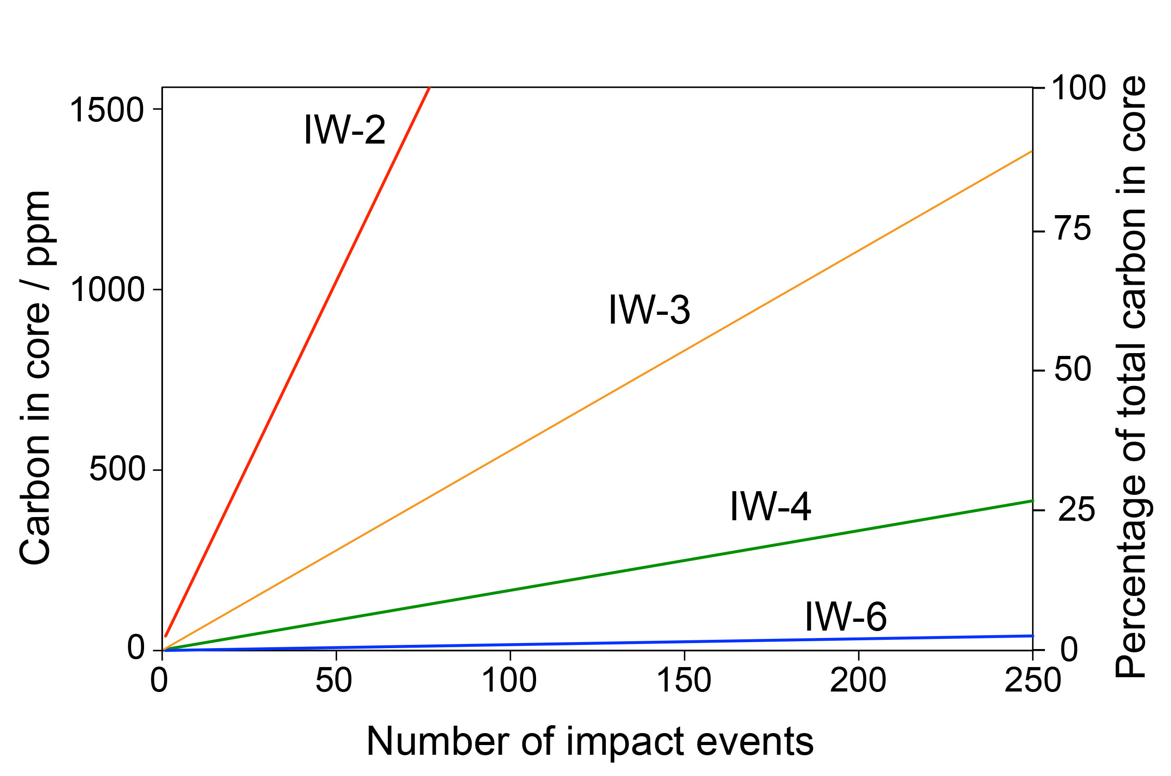
Keppler and Golabek
Graphite floatation on a magma ocean and the fate of carbon during core formation
Figure 4 The fate of carbon during core formation of a terrestrial planet. Maximum possible carbon content in the core as a function of the number of impact events by planetary embryos, for oxygen fugacities from IW-6 to IW-2 and a surface temperature of 2000 K (left scale); predicted maximum fraction of total carbon sequestered in the core (right scale) for a terrestrial planet with a bulk carbon content of 500 ppm (Marty, 2012).
© 2019 The Authors
Published by the European Association of Geochemistry
under Creative Commons License CC BY-NC-ND.
Keppler and Golabek (2019) Geochem. Persp. Let. 11, 12-17 | doi: 10.7185/geochemlet.1918
Notes:
Figure 4 The fate of carbon during core formation of a terrestrial planet. Maximum possible carbon content in the core as a function of the number of impact events by planetary embryos, for oxygen fugacities from IW-6 to IW-2 and a surface temperature of 2000 K (left scale); predicted maximum fraction of total carbon sequestered in the core (right scale) for a terrestrial planet with a bulk carbon content of 500 ppm (Marty, 2012).

