Slide 1
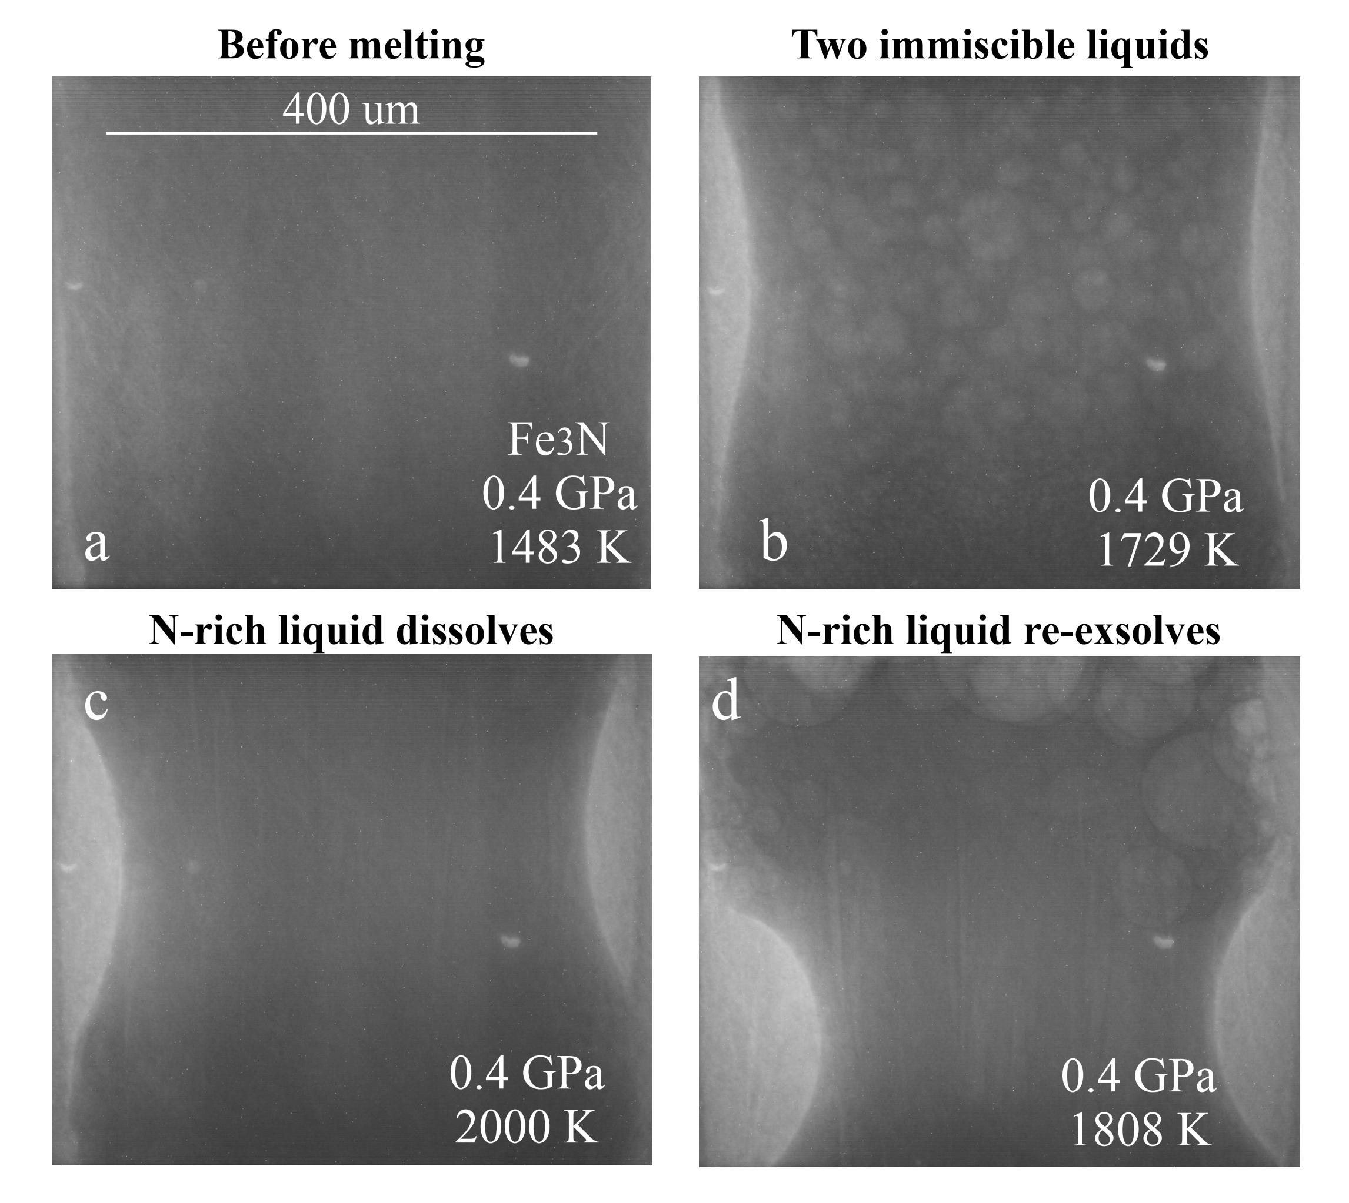
Liu et al.
Loss of immiscible nitrogen from metallic melt explains Earth’s missing nitrogen
Figure 1 Representative X-ray radiographic images showing the evolution of the miscibility gap in Fe-N-C system under high pressure and high temperature conditions (run 4-17). This in situ X-ray radiography experiment starts at 0.4 GPa with Fe₃N as the starting material. (a) The sample is below solidus at 0.4 GPa and 1483 K. (b) Around 1729 K, immiscible N-rich supercritical fluid coexists with metallic liquid. (c) At higher temperatures, N-rich supercritical fluid partially dissolves into metallic liquid. (d) Lowering temperature re-exsolves N-rich supercritical fluid from metallic liquid. The corresponding movie is shown in Video S-1.
© 2019 The Authors
Published by the European Association of Geochemistry
under Creative Commons License CC BY-NC-ND.
Liu et al. (2019) Geochem. Persp. Let. 11, 18-22 | doi: 10.7185/geochemlet.1919
Notes:
Figure 1 Representative X-ray radiographic images showing the evolution of the miscibility gap in Fe-N-C system under high pressure and high temperature conditions (run 4-17). This in situ X-ray radiography experiment starts at 0.4 GPa with Fe₃N as the starting material. (a) The sample is below solidus at 0.4 GPa and 1483 K. (b) Around 1729 K, immiscible N-rich supercritical fluid coexists with metallic liquid. (c) At higher temperatures, N-rich supercritical fluid partially dissolves into metallic liquid. (d) Lowering temperature re-exsolves N-rich supercritical fluid from metallic liquid. The corresponding movie is shown in Video S-1.

