Slide 1
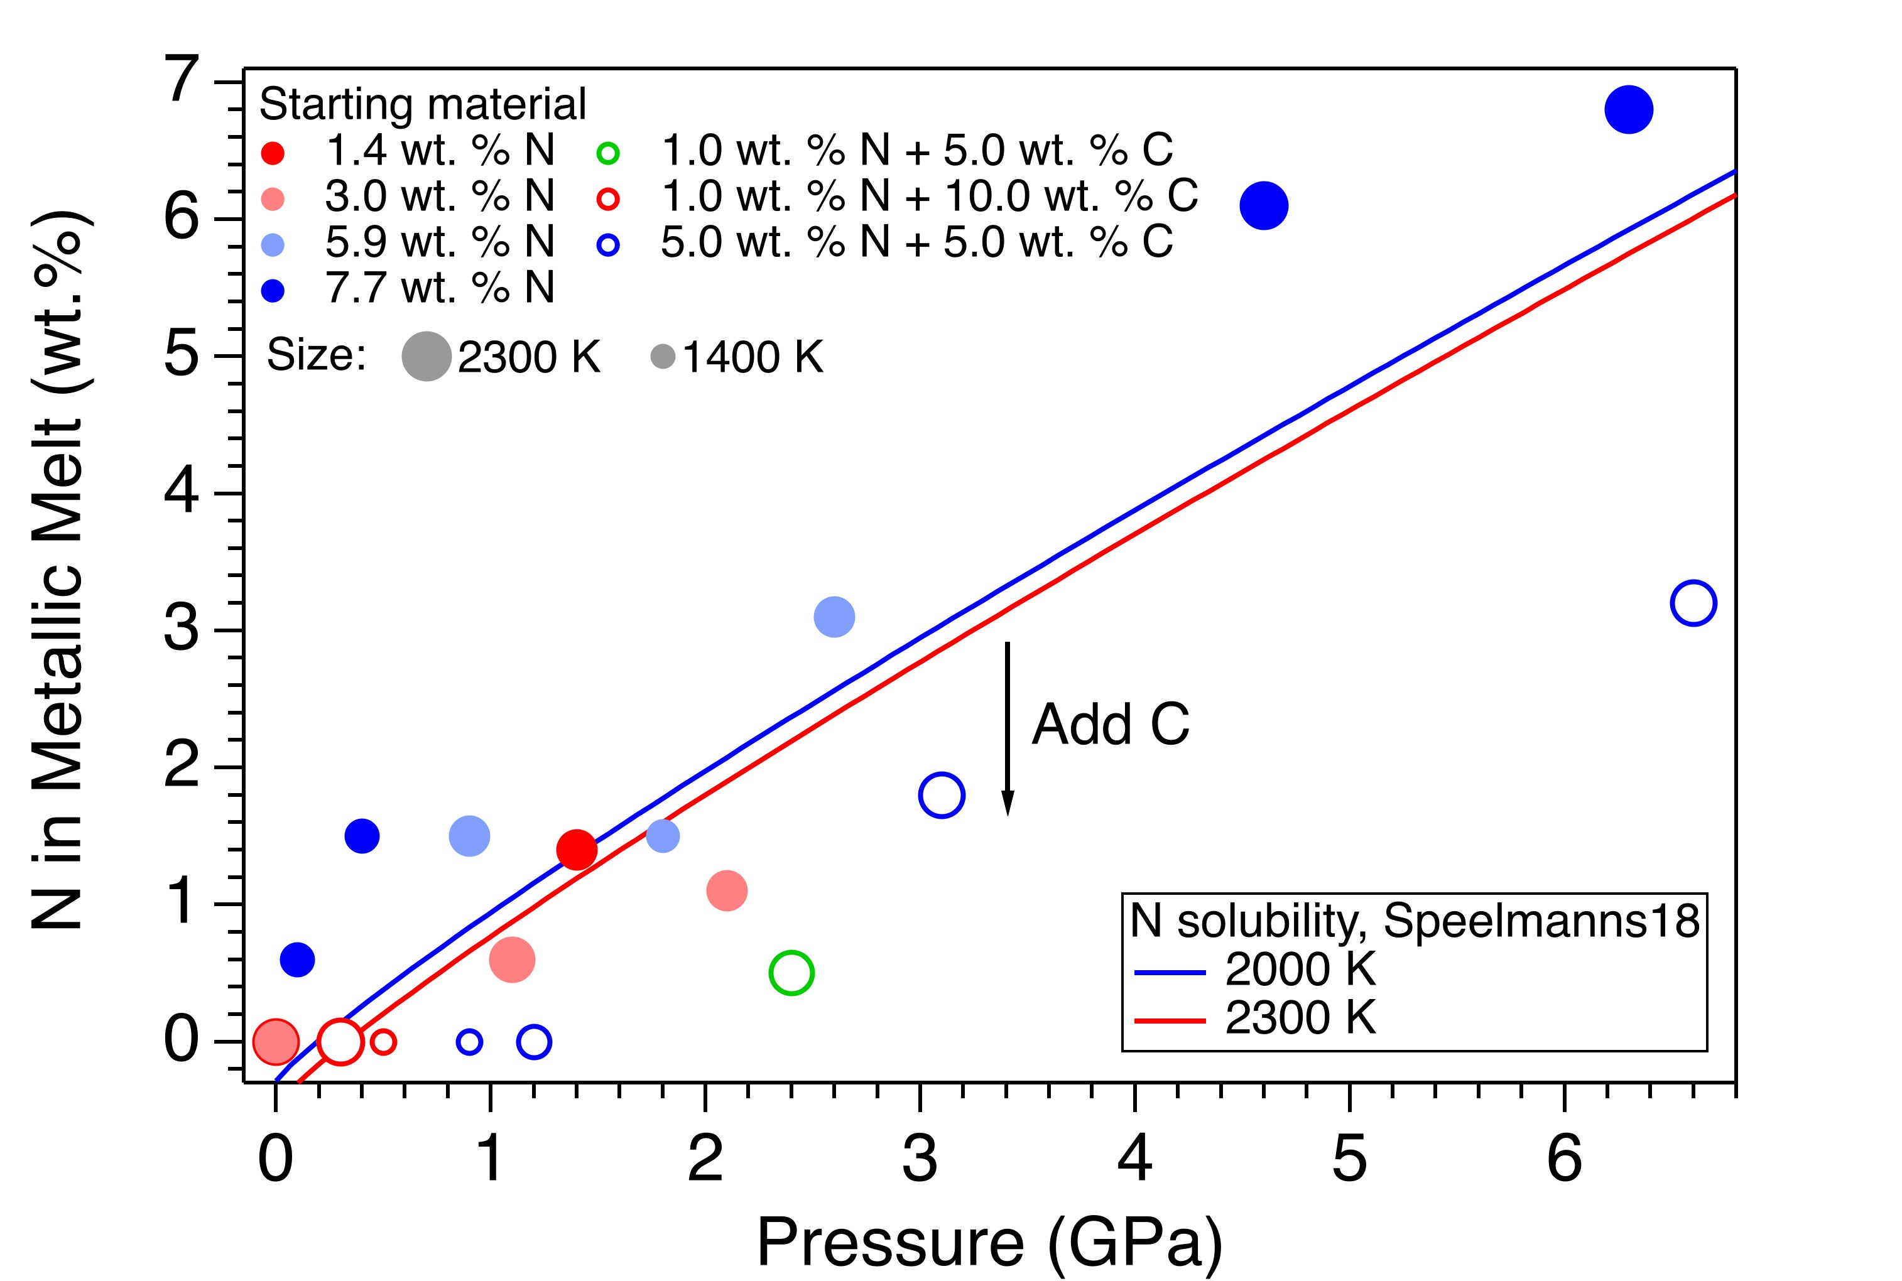
Liu et al.
Loss of immiscible nitrogen from metallic melt explains Earth’s missing nitrogen
Figure 2 The pressure dependence of N solubility in Fe-N-C melt. The solid circles are for Fe-N starting materials; the open circles are for Fe-N-C starting materials. Symbol sizes are proportional to the temperatures (1400-2300 K) at which the experiments are quenched and colours indicate initial compositions (see legend). The blue and red curves are modelled N solubilities in Fe-N-C melt at 2000 K and 2300 K, respectively, from Speelmanns et al. (2018).
© 2019 The Authors
Published by the European Association of Geochemistry
under Creative Commons License CC BY-NC-ND.
Liu et al. (2019) Geochem. Persp. Let. 11, 18-22 | doi: 10.7185/geochemlet.1919
Notes:
Figure 2 The pressure dependence of N solubility in Fe-N-C melt. The solid circles are for Fe-N starting materials; the open circles are for Fe-N-C starting materials. Symbol sizes are proportional to the temperatures (1400-2300 K) at which the experiments are quenched and colours indicate initial compositions (see legend). The blue and red curves are modelled N solubilities in Fe-N-C melt at 2000 K and 2300 K, respectively, from Speelmanns et al. (2018).

