Slide 1
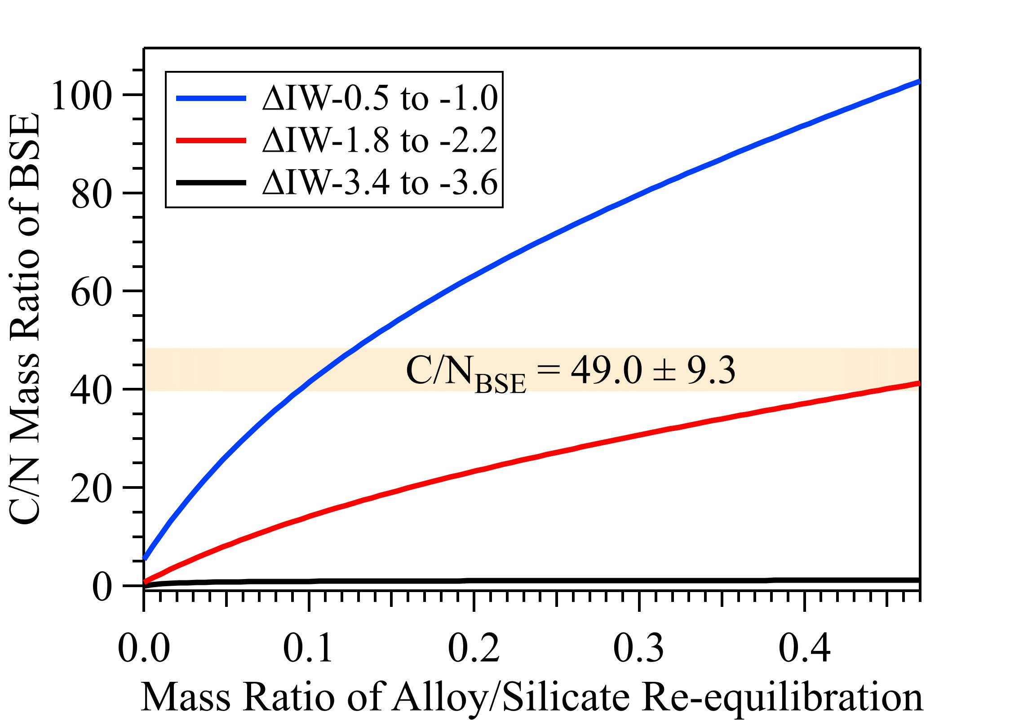
Liu et al.
Loss of immiscible nitrogen from metallic melt explains Earth’s missing nitrogen
Figure 3 The evolution of the BSE C/N ratio with the degree of re-equilibration between alloy and silicate melts during core formation. The blue curve is calculated at oxidised conditions (ΔIW-0.5 to ΔIW-1.0); the red curve is for reduced conditions (ΔIW-1.8 to ΔIW-2.2) and the black curve is for very reduced conditions (ΔIW-3.4 to ΔW-3.6). The horizontal yellow bar marks the range of the estimated present BSE C/N ratio (Bergin et al., 2015).
© 2019 The Authors
Published by the European Association of Geochemistry
under Creative Commons License CC BY-NC-ND.
Liu et al. (2019) Geochem. Persp. Let. 11, 18-22 | doi: 10.7185/geochemlet.1919
Notes:
Figure 3 The evolution of the BSE C/N ratio with the degree of re-equilibration between alloy and silicate melts during core formation. The blue curve is calculated at oxidised conditions (ΔIW-0.5 to ΔIW-1.0); the red curve is for reduced conditions (ΔIW-1.8 to ΔIW-2.2) and the black curve is for very reduced conditions (ΔIW-3.4 to ΔIW-3.6). The horizontal yellow bar marks the range of the estimated present BSE C/N ratio (Bergin et al., 2015).

