Slide 1
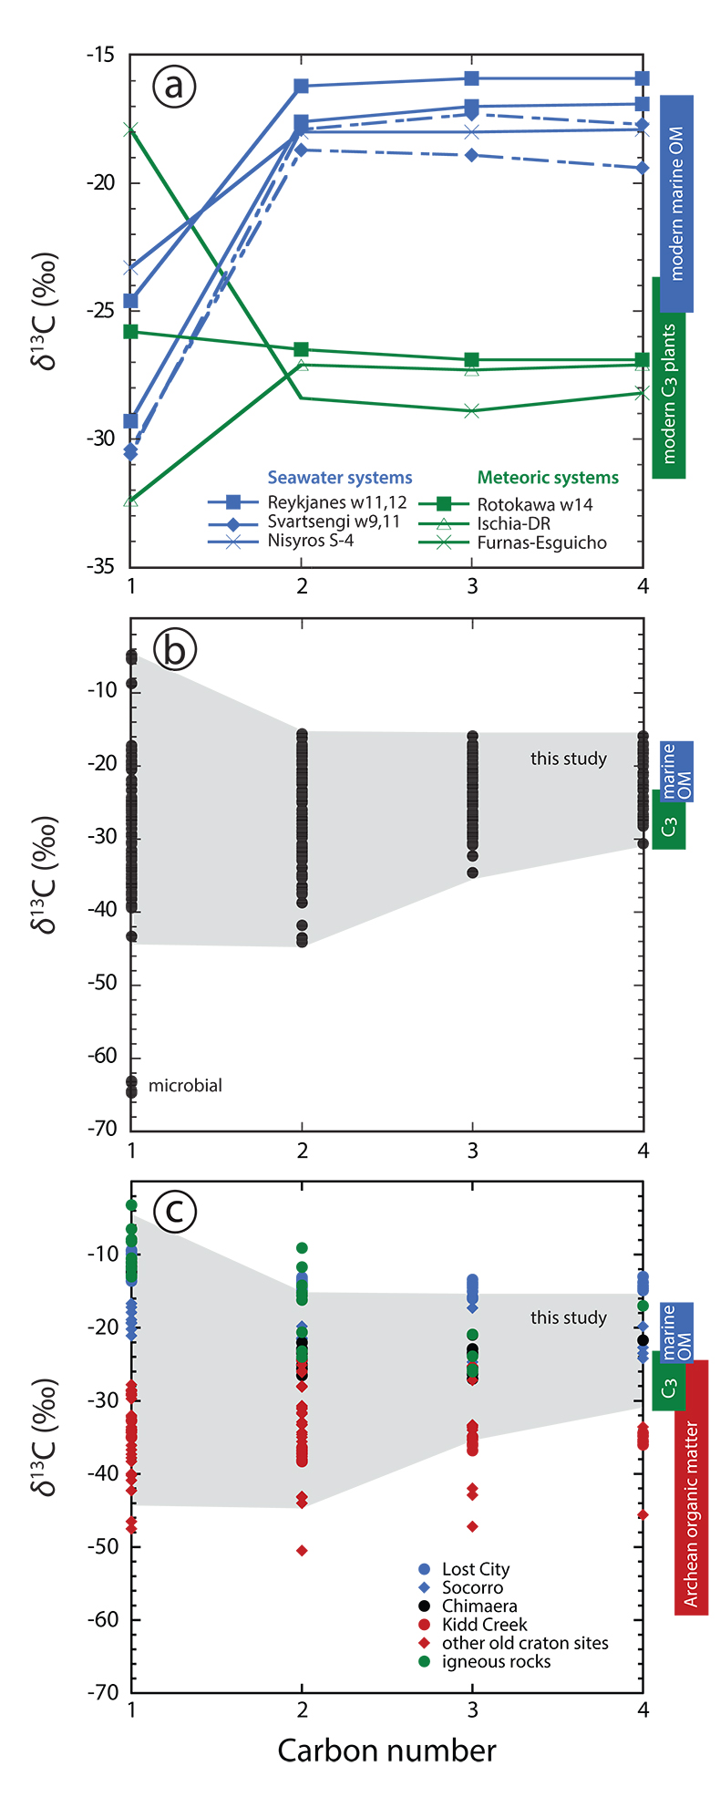
Fiebig et al.
Abiogenesis not required to explain the origin of volcanic-hydrothermal hydrocarbons
Figure 1 Plot of 𝛿¹³C of individual n-alkanes against carbon number. 𝛿¹³C ranges of modern marine organic matter (Druffel et al., 1992; Sara et al., 2007), terrestrial C₃ vegetation (Kohn, 2010) and Archean organic matter (Hayes and Waldbauer, 2006) are shown for comparison. (a) Emissions that are characterised by invariant 𝛿¹³C-C₂₊. (b) Compilation of all n-alkane data analysed in this study. (c) Comparison between n-alkane data from this study (area in grey) and data available from abiotic sites (Supplementary Information): hydrothermal sites (blue); ophiolite gases (black); old craton gases (red) and inclusions in igneous rocks (green).
© 2019 The Authors
Published by the European Association of Geochemistry
under Creative Commons License CC BY-NC-ND.
Fiebig et al. (2019) Geochem. Persp. Let. 11, 23-27 | doi: 10.7185/geochemlet.1920
Notes:
Figure 1 Plot of 𝛿¹³C of individual n-alkanes against carbon number. 𝛿¹³C ranges of modern marine organic matter (Druffel et al., 1992; Sara et al., 2007), terrestrial C₃ vegetation (Kohn, 2010) and Archean organic matter (Hayes and Waldbauer, 2006) are shown for comparison. (a) Emissions that are characterised by invariant 𝛿¹³C-C₂₊. (b) Compilation of all n-alkane data analysed in this study. (c) Comparison between n-alkane data from this study (area in grey) and data available from abiotic sites (Supplementary Information): hydrothermal sites (blue); ophiolite gases (black); old craton gases (red) and inclusions in igneous rocks (green).

