Slide 1
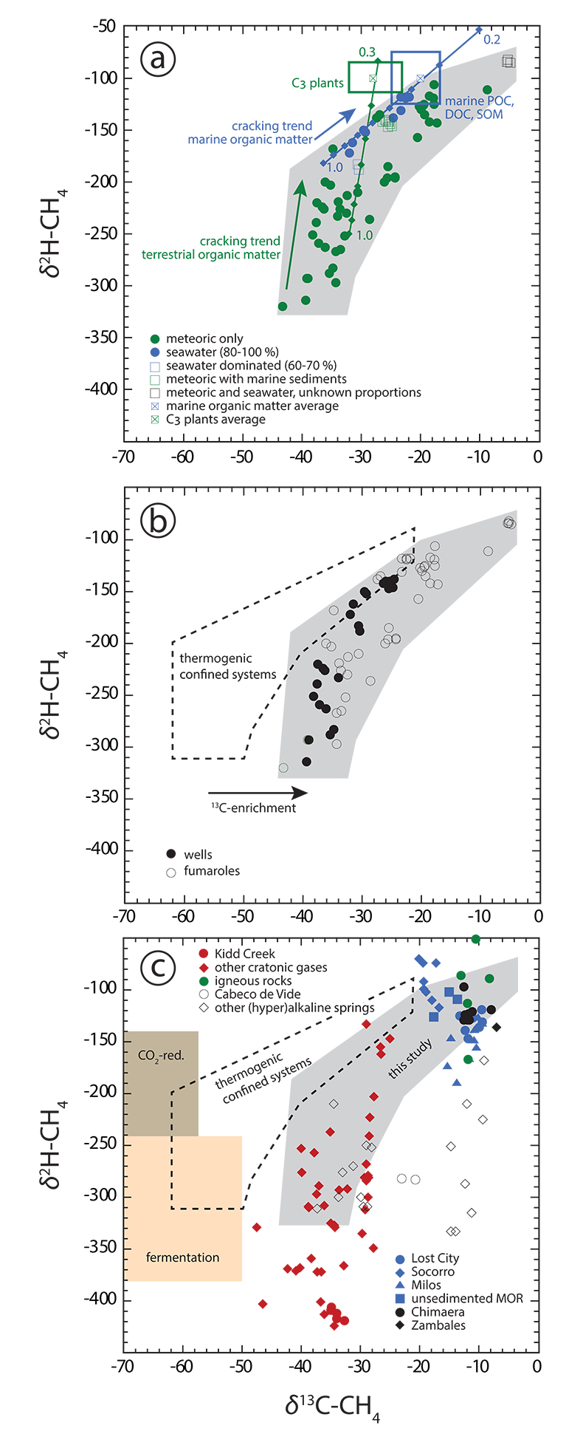
Fiebig et al.
Abiogenesis not required to explain the origin of volcanic-hydrothermal hydrocarbons
Figure 2 Plot of 𝛿²H-CH₄ vs. 𝛿¹³C-CH₄. Samples with an obvious microbial origin (𝛿¹³C-CH₄ < –60 ‰, Fig. 1b) are not considered. (a) Data classified after the origin of external water feeding the hydrothermal system (Table S-1). Blue and green squares are representative of the carbon and hydrogen isotopic compositions of marine organic matter and C₃ plants, respectively (Schoell, 1984). The carbon and hydrogen isotopic compositions of instantaneously generated fractions of methane deriving from open system cracking of marine and terrestrial (C₃ plants) organic matter were modelled as a function of the fraction of precursor sites remaining inside the cracked organic matter (Supplementary Information). The cracking trend for methane deriving from marine organic matter (blue line) matches the variation of 𝛿¹³C-CH₄ and 𝛿²H-CH₄ observed for seawater-fed hydrothermal systems (blue data points). The cracking trend for…
© 2019 The Authors
Published by the European Association of Geochemistry
under Creative Commons License CC BY-NC-ND.
Fiebig et al. (2019) Geochem. Persp. Let. 11, 23-27 | doi: 10.7185/geochemlet.1920
Notes:
Figure 2 Plot of 𝛿²H-CH₄ vs. 𝛿¹³C-CH₄. Samples with an obvious microbial origin (𝛿¹³C-CH₄ < –60 ‰, Fig. 1b) are not considered. (a) Data classified after the origin of external water feeding the hydrothermal system (Table S-1). Blue and green squares are representative of the carbon and hydrogen isotopic compositions of marine organic matter and C₃ plants, respectively (Schoell, 1984). The carbon and hydrogen isotopic compositions of instantaneously generated fractions of methane deriving from open system cracking of marine and terrestrial (C₃ plants) organic matter were modelled as a function of the fraction of precursor sites remaining inside the cracked organic matter (Supplementary Information). The cracking trend for methane deriving from marine organic matter (blue line) matches the variation of 𝛿¹³C-CH₄ and 𝛿²H-CH₄ observed for seawater-fed hydrothermal systems (blue data points). The cracking trend for methane from terrestrial organic matter (green line) corresponds to the slope described by most low 𝛿¹³C-CH₄ samples from meteoric water-fed hydrothermal systems (green data points), but – on average – occurs shifted relative to the latter to higher 𝛿¹³C and 𝛿²H. This implies that methane precursor sites in decomposing terrestrial organic matter either occur depleted in ¹³C and ²H with respect to the average C₃ plant isotopic composition or that the corresponding carbon and hydrogen isotope fractionations (α_{C}, α_{H}) are larger than those obtained from xylite (Berner et al., 1995), with α_{H} /α_{C} remaining unchanged. Both possibilities are consistent with carbon isotope constraints on pyrolysis of coal (Cramer et al., 1998). (b) Data classified after the style of degassing (wells vs. fumaroles). (c) Comparison between methane data from this study and data available from other abiotic sites (Supplementary Information): labelling as in Figure 1c, extended by (hyper)alkaline spring data (open symbols). Field characteristic for methane from microbial (c) and confined sedimentary systems (b, c) redrawn after Schoell (1988).

