Slide 1
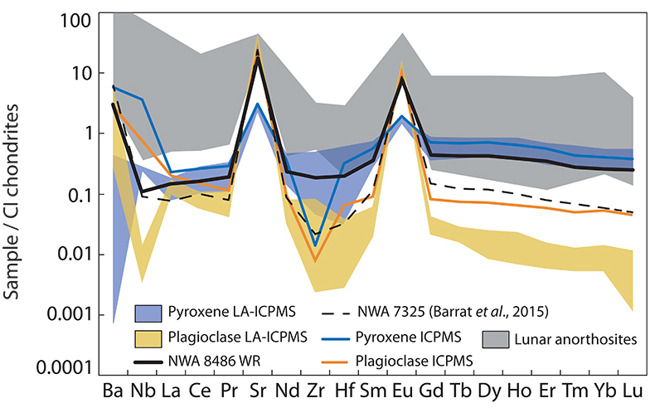
Frossard et al.
Evidence for anorthositic crust formed on an inner solar system planetesimal
Figure 1 Trace element composition of NWA 8486 normalised to CI chondrites (Anders and Grevesse, 1989). All fractions exhibit Eu and Sr positive anomalies. NWA 7325 has a lower content for most incompatible elements compared to NWA 8486 owing to its modal enrichment in plagioclase. Lunar anorthosites are reported for comparison (data from Haskin et al., 1973 and Norman et al., 2003).
© 2019 The Authors
Published by the European Association of Geochemistry
under Creative Commons License CC BY-NC-ND.
Frossard et al. (2019) Geochem. Persp. Let. 11, 28-32 | doi: 10.7185/geochemlet.1921
Notes:
Figure 1 Trace element composition of NWA 8486 normalised to CI chondrites (Anders and Grevesse, 1989). All fractions exhibit Eu and Sr positive anomalies. NWA 7325 has a lower content for most incompatible elements compared to NWA 8486 owing to its modal enrichment in plagioclase. Lunar anorthosites are reported for comparison (data from Haskin et al., 1973 and Norman et al., 2003).

