Slide 1
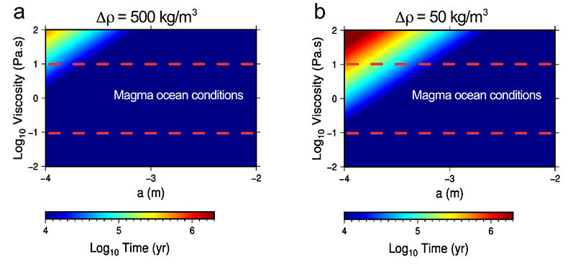
Frossard et al.
Evidence for anorthositic crust formed on an inner solar system planetesimal
Figure 4 Time for plagioclase crystal ascent during the late stage of a magma ocean. This time is calculated for a range of viscosities (0.1 to 10 Pa.s), crystal diameters (a; 100 µm to 1 cm) and density contrasts (∆ρ; 50 to 500 kg/m³) between the crystal and the liquid phase. The time for a crystal to reach the surface of the magma ocean is represented with a colour scale ranging between 10 kyr (blue) and 2 Myr (red). Both panels show that the time of ascent of the crystal is a few tens of thousands of years in magma ocean conditions, except for small crystals around 100 µm and high viscosities of >10 Pa.s for which time of ascent is longer.
© 2019 The Authors
Published by the European Association of Geochemistry
under Creative Commons License CC BY-NC-ND.
Frossard et al. (2019) Geochem. Persp. Let. 11, 28-32 | doi: 10.7185/geochemlet.1921
Notes:
Figure 4 Time for plagioclase crystal ascent during the late stage of a magma ocean. This time is calculated for a range of viscosities (0.1 to 10 Pa.s), crystal diameters (a; 100 µm to 1 cm) and density contrasts (∆ρ; 50 to 500 kg/m³) between the crystal and the liquid phase. The time for a crystal to reach the surface of the magma ocean is represented with a colour scale ranging between 10 kyr (blue) and 2 Myr (red). Both panels show that the time of ascent of the crystal is a few tens of thousands of years in magma ocean conditions, except for small crystals around 100 µm and high viscosities of >10 Pa.s for which time of ascent is longer.

