Slide 1
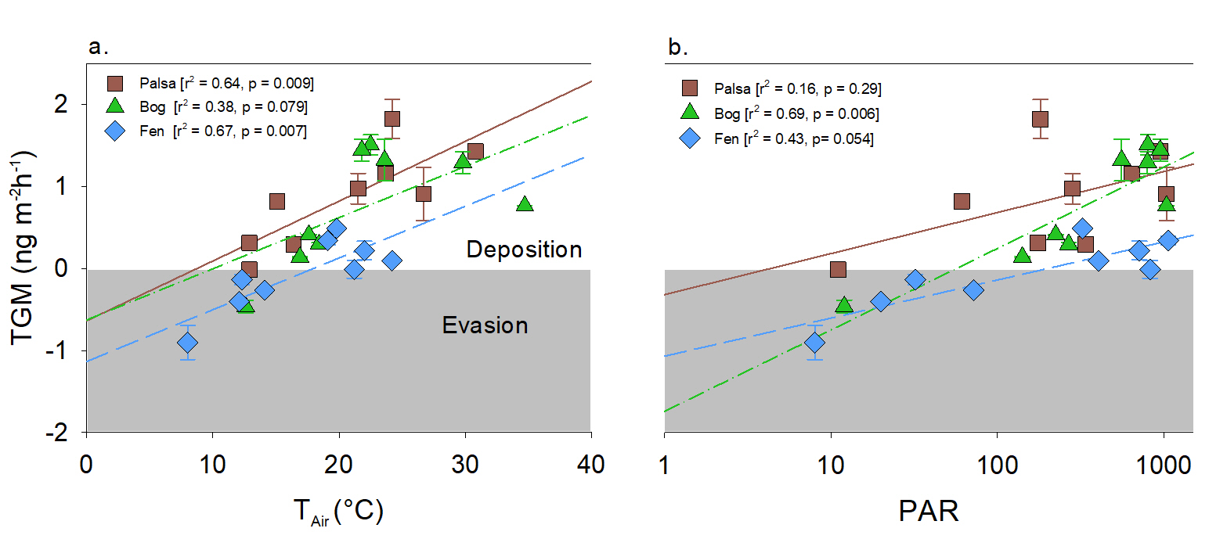
Fahnestock et al.
Mercury reallocation in thawing subarctic peatlands
Figure 1 (a) Relationships between TGM flux and ambient air temperature (°C) and (b) photosynthetically active radiation (PAR). Symbols denote palsa (brown squares), bog (green triangles) and fen (blue diamonds) and include least squares linear regressions and associated r² and p values. Evasion of TGM interpreted for values greater than zero and deposition for values less than zero.
© 2019 The Authors
Published by the European Association of Geochemistry
under Creative Commons License CC BY-NC-ND.
Fahnestock et al. (2019) Geochem. Persp. Let. 11, 33-38 | doi: 10.7185/geochemlet.1922
Notes:
Figure 1 (a) Relationships between TGM flux and ambient air temperature (°C) and (b) photosynthetically active radiation (PAR). Symbols denote palsa (brown squares), bog (green triangles) and fen (blue diamonds) and include least squares linear regressions and associated r² and p values. Evasion of TGM interpreted for values greater than zero and deposition for values less than zero.

