Slide 1
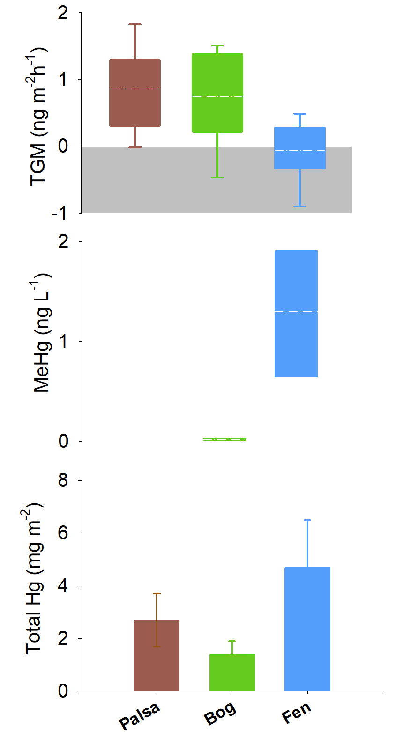
Fahnestock et al.
Mercury reallocation in thawing subarctic peatlands
Figure 2 Summarised Hg in the three sub-habitats (from top to bottom): TGM, porewater methyl Hg (MeHg), and total peat Hg (corrected for dry bulk density).
© 2019 The Authors
Published by the European Association of Geochemistry
under Creative Commons License CC BY-NC-ND.
Fahnestock et al. (2019) Geochem. Persp. Let. 11, 33-38 | doi: 10.7185/geochemlet.1922
Notes:
Figure 2 Summarised Hg in the three sub-habitats (from top to bottom): TGM, porewater methyl Hg (MeHg), and total peat Hg (corrected for dry bulk density).

