Slide 1
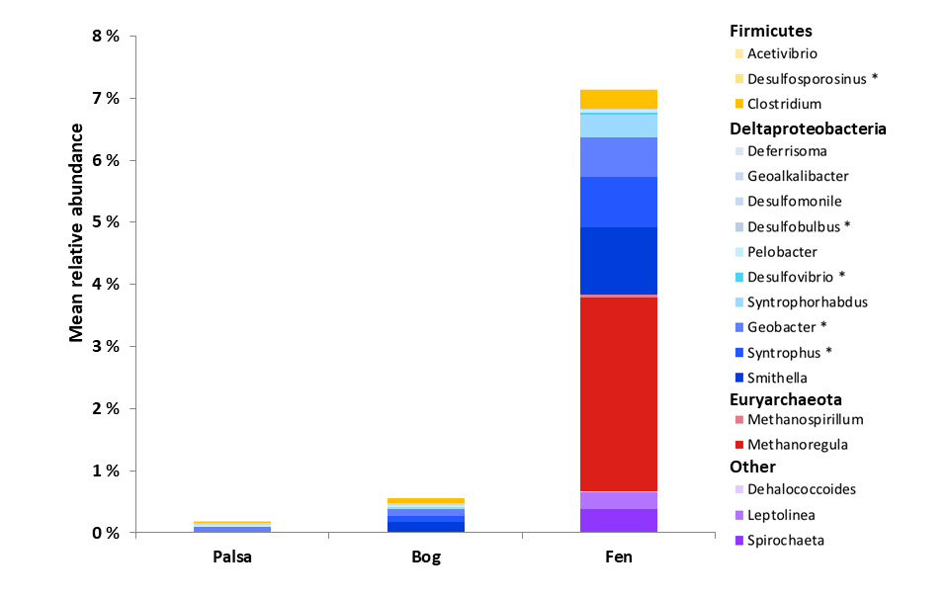
Fahnestock et al.
Mercury reallocation in thawing subarctic peatlands
Figure 3 Mean relative abundance of potential Hg methylators at Stordalen Mire (n = 38 for palsa, 47 for bog, and 42 for fen), using microbial community data from 2010-2012 reanalysed from Mondav et al. (2017). * indicates genera with members experimentally confirmed to methylate Hg.
© 2019 The Authors
Published by the European Association of Geochemistry
under Creative Commons License CC BY-NC-ND.
Fahnestock et al. (2019) Geochem. Persp. Let. 11, 33-38 | doi: 10.7185/geochemlet.1922
Notes:
Figure 3 Mean relative abundance of potential Hg methylators at Stordalen Mire (n = 38 for palsa, 47 for bog, and 42 for fen), using microbial community data from 2010-2012 reanalysed from Mondav et al. (2017). * indicates genera with members experimentally confirmed to methylate Hg.

