Slide 1
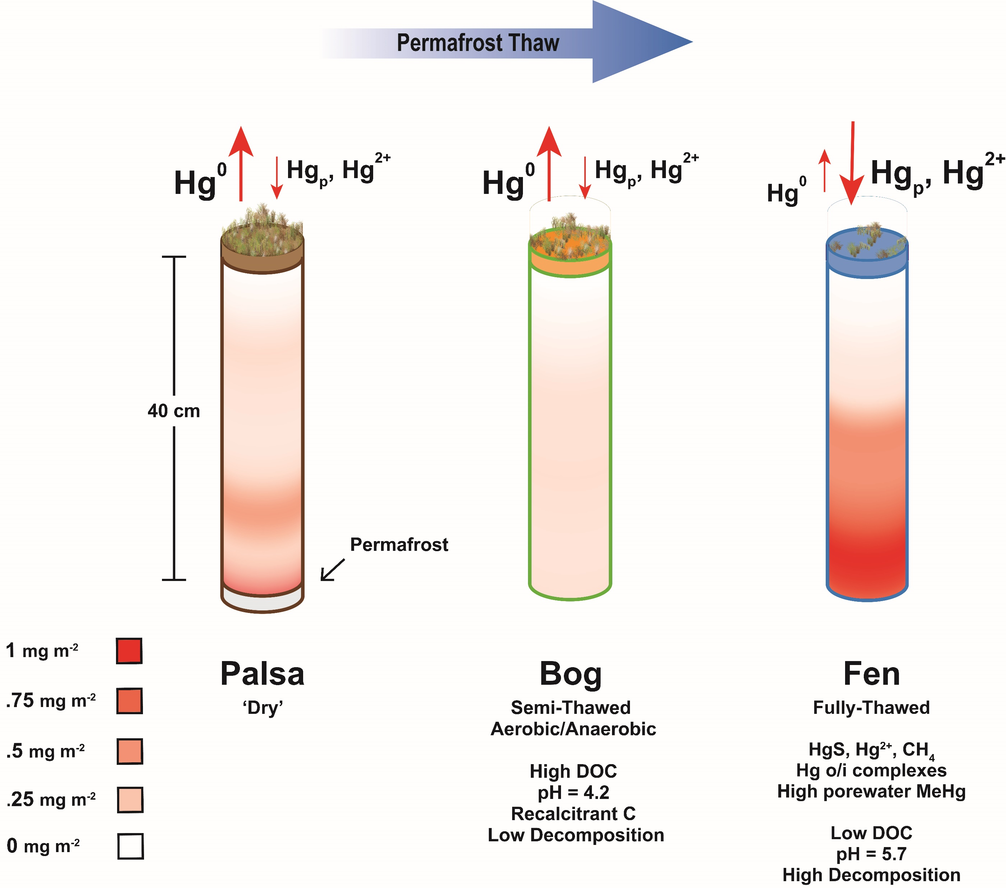
Fahnestock et al.
Mercury reallocation in thawing subarctic peatlands
Figure 4 Schematic of biogeochemical Hg cycling across permafrost thaw with emphasis on Hg pools and major pathways. Red arrows denote gaseous (Hg⁰) flux for each stage of the thaw sequence. Peat inventories are for total Hg for the top 40 cm of the mire surface (cf. legend for corresponding range).
© 2019 The Authors
Published by the European Association of Geochemistry
under Creative Commons License CC BY-NC-ND.
Fahnestock et al. (2019) Geochem. Persp. Let. 11, 33-38 | doi: 10.7185/geochemlet.1922
Notes:
Figure 4 Schematic of biogeochemical Hg cycling across permafrost thaw with emphasis on Hg pools and major pathways. Red arrows denote gaseous (Hg⁰) flux for each stage of the thaw sequence. Peat inventories are for total Hg for the top 40 cm of the mire surface (cf. legend for corresponding range).

