Slide 1
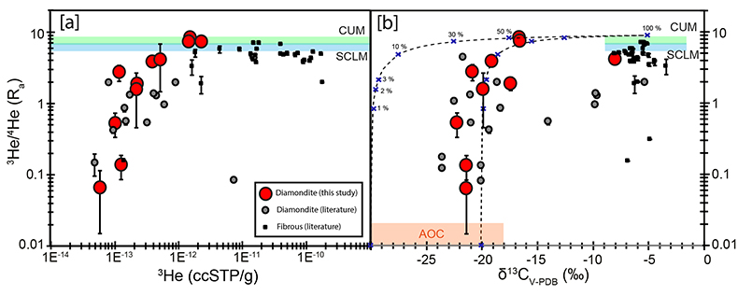
Mikhail et al.
A secretive mechanical exchange between mantle and crustal volatiles revealed by helium isotopes in ¹³C-depleted diamonds
Figure 2 (a) Helium isotope systematics of fluids released by in vacuo crushing of diamondites. The ³He/⁴He of modern the convecting upper mantle (CUM) and the sub-continental lithospheric mantle (SCLM) are shown for reference. (b) Carbon-helium isotope systematics of southern African diamondites and fibrous diamonds from across southern Africa. The mixing lines are plotted between mantle and crustal fluid sources, the crosses refer to percent of mantle fluid component. The mixing lines plotted in Figure 2b are hyperbolic as [⁴He]_{mantle}/[⁴He]_{crust} is assumed to be 10. Comparative data are from Burgess et al. (1998), Gautheron et al. (2005) and Timmermann et al. (2018, 2019a).
© 2019 The Authors
Published by the European Association of Geochemistry
under Creative Commons License CC BY-NC-ND.
Mikhail et al. (2019) Geochem. Persp. Let. 11, 39-43 | doi: 10.7185/geochemlet.1923
Notes:
Figure 2 (a) Helium isotope systematics of fluids released by in vacuo crushing of diamondites. The ³He/⁴He of modern the convecting upper mantle (CUM) and the sub-continental lithospheric mantle (SCLM) are shown for reference. (b) Carbon-helium isotope systematics of southern African diamondites and fibrous diamonds from across southern Africa. The mixing lines are plotted between mantle and crustal fluid sources, the crosses refer to percent of mantle fluid component. The mixing lines plotted in Figure 2b are hyperbolic as [⁴He]_{mantle}/[⁴He]_{crust} is assumed to be 10. Comparative data are from Burgess et al. (1998), Gautheron et al. (2005) and Timmermann et al. (2018, 2019a).

