Slide 1
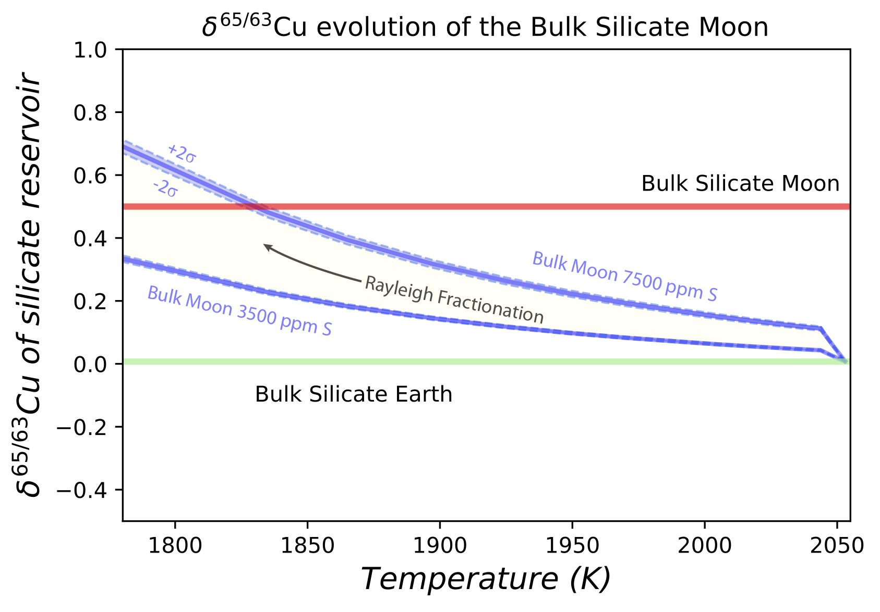
Xia et al.
The effect of core segregation on the Cu and Zn isotope composition of the silicate Moon
Figure 3 The Cu isotope evolution of the silicate Moon during lunar sulfide segregation. Assuming the Moon is derived from the precursor BSE, and the Moon’s core is predominantly FeS (equating to a bulk Moon of ~7500 ppm S), or just the outer core (3500 ppm S) and sulfide sequestration occurs by Rayleigh fractionation, the silicate Moon becomes progressively lighter in Cu. Horizontal lines represent values of the BSM estimated by lunar basalts (red) and the BSE (green) (Herzog et al., 2009). The pale blue band represents 2 standard deviations of the error on the mean of the fractionation regression.
© 2019 The Authors
Published by the European Association of Geochemistry
under Creative Commons License CC BY 4.0.
Xia et al. (2019) Geochem. Persp. Let. 12, 12-17 | doi: 10.7185/geochemlet.1928
Notes:
Figure 3 The Cu isotope evolution of the silicate Moon during lunar sulfide segregation. Assuming the Moon is derived from the precursor BSE, and the Moon’s core is predominantly FeS (equating to a bulk Moon of ~7500 ppm S), or just the outer core (3500 ppm S) and sulfide sequestration occurs by Rayleigh fractionation, the silicate Moon becomes progressively lighter in Cu. Horizontal lines represent values of the BSM estimated by lunar basalts (red) and the BSE (green) (Herzog et al., 2009). The pale blue band represents 2 standard deviations of the error on the mean of the fractionation regression.

