Slide 1
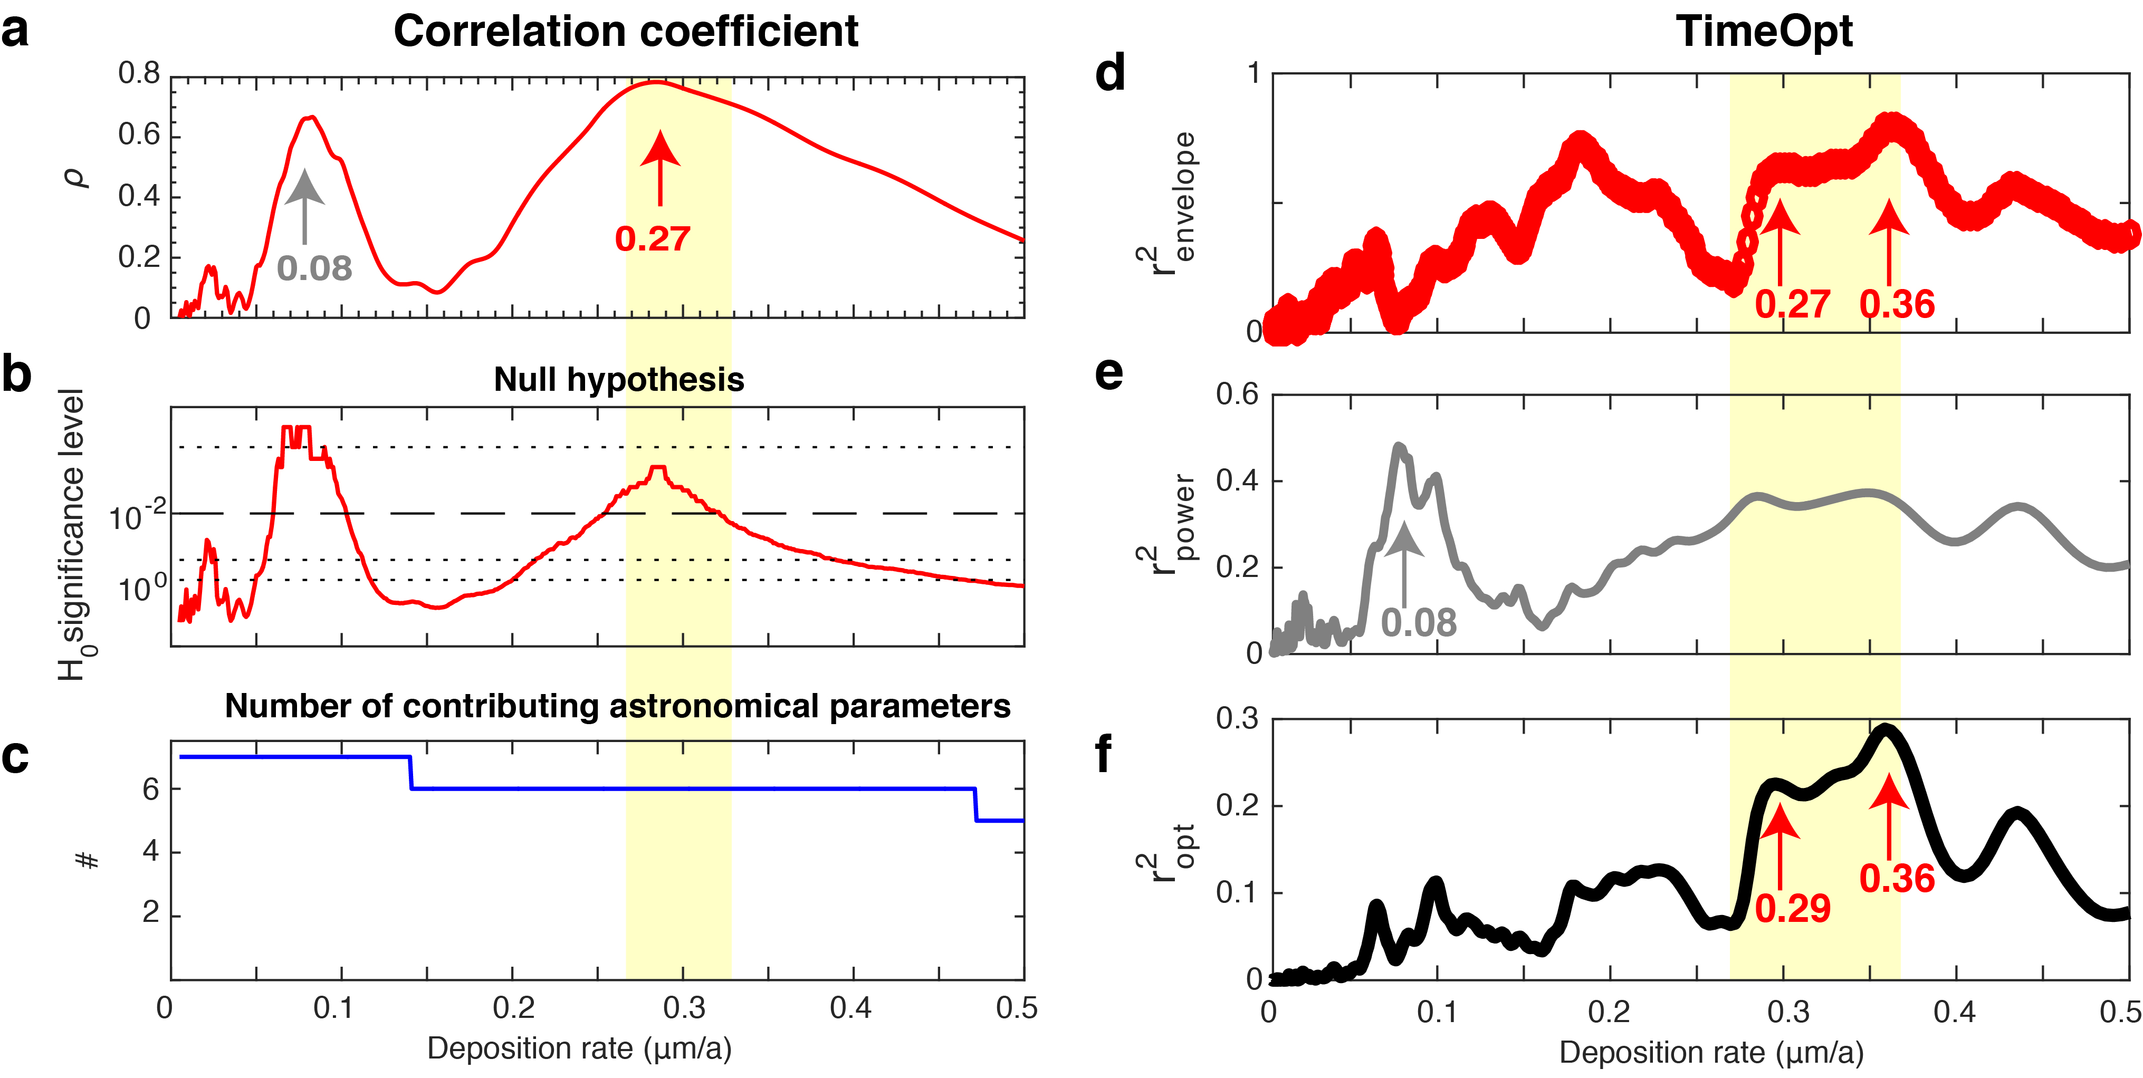
Li and Barnes
Orbitally forced sphalerite growth in the Upper Mississippi Valley District
Figure 4 Sphalerite deposition rate. (a) The COCO analysis shows optimal deposition rate at 0.27 μm/a. (b) Null hypothesis testing of the data series indicates that 0.08 μm/a and 0.27 μm/a deposition rates have significance levels less than 1 %. (c) Number of contributing astronomical parameters. (d) Squared correlation coefficient for the amplitude envelope fit (r²_{envelope}) and (e) the spectral power fit (r²_{power}). (f) Combined envelope and spectral power fit (r²_{opt}) at test deposition rate.
© 2019 The Authors
Published by the European Association of Geochemistry
under Creative Commons License CC BY-NC-ND.
Li and Barnes (2019) Geochem. Persp. Let. 12, 18-22 | doi: 10.7185/geochemlet.1929
Notes:
Figure 4 Sphalerite deposition rate. (a) The COCO analysis shows optimal deposition rate at 0.27 μm/a. (b) Null hypothesis testing of the data series indicates that 0.08 μm/a and 0.27 μm/a deposition rates have significance levels less than 1 %. (c) Number of contributing astronomical parameters. (d) Squared correlation coefficient for the amplitude envelope fit (r²_{envelope}) and (e) the spectral power fit (r²_{power}). (f) Combined envelope and spectral power fit (r²_{opt}) at test deposition rate.

