Slide 1
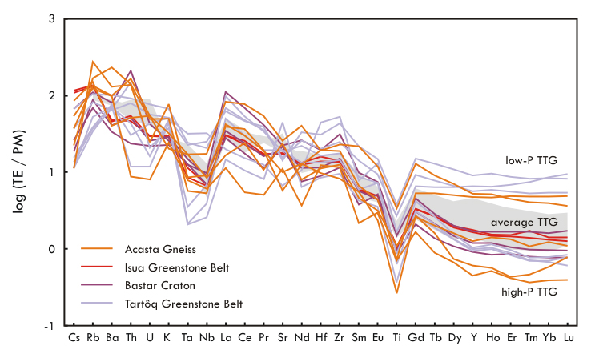
Smit et al.
Formation of Archean continental crust constrained by boron isotopes
Figure 1 Trace element concentrations for the TTG samples and average TTG (Moyen and Martin, 2012). All data are normalised to primitive mantle (PM; data in Table S-7).
© 2019 The Authors
Published by the European Association of Geochemistry
under Creative Commons License CC BY-NC-ND.
Li and Barnes (2019) Geochem. Persp. Let. 12, 23-26 | doi: 10.7185/geochemlet.1930
Notes:
Figure 1 Trace element concentrations for the TTG samples and average TTG (Moyen and Martin, 2012). All data are normalised to primitive mantle (PM; data in Table S-7).

