Slide 1
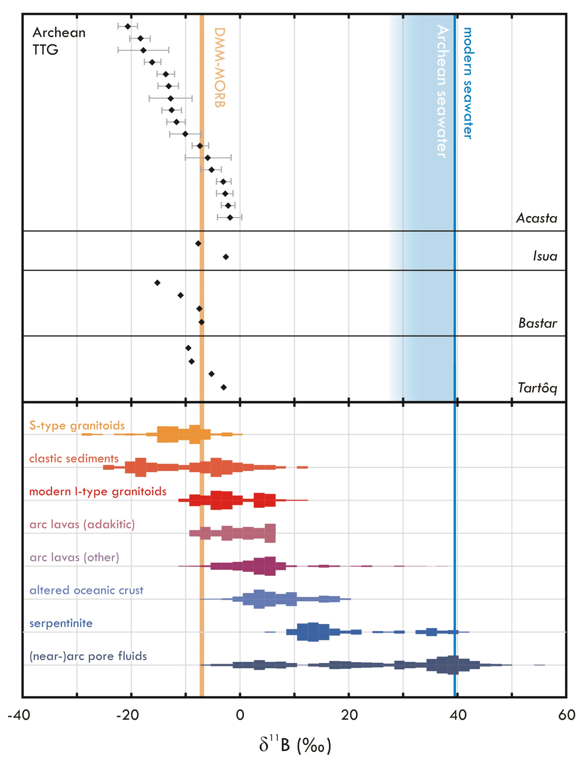
Smit et al.
Formation of Archean continental crust constrained by boron isotopes
Figure 3 Boron isotope data for the analysed samples and terrestrial reservoirs (histograms). Error bars for whole rock analyses are smaller than the symbols. Acasta data represents bulk rock δ¹¹B modelled from biotite data (Supplementary Information, Analytical Methods and Data). The values for reference reservoirs are in Table S-1.
© 2019 The Authors
Published by the European Association of Geochemistry
under Creative Commons License CC BY-NC-ND.
Li and Barnes (2019) Geochem. Persp. Let. 12, 23-26 | doi: 10.7185/geochemlet.1930
Notes:
Figure 3 Boron isotope data for the analysed samples and terrestrial reservoirs (histograms). Error bars for whole rock analyses are smaller than the symbols. Acasta data represents bulk rock δ¹¹B modelled from biotite data (Supplementary Information, Analytical Methods and Data). The values for reference reservoirs are in Table S-1.

