Slide 1
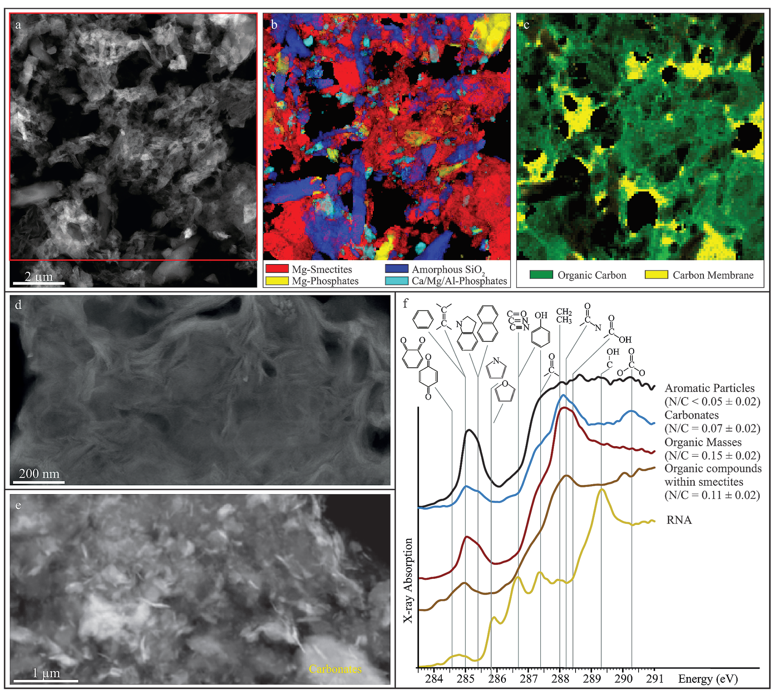
Viennet et al.
Experimental clues for detecting biosignatures on Mars
Figure 1 STEM and STXM characterisation of the experimental residues. (a) STEM image of the residues of experiments conducted under CO₂ at 200 °C in the presence of Mg-smectites and RNA. (b,c) Maps of minerals and organic compounds (same area as a). (d) STEM images of Mg-smectites. (e) STEM image of sub-micrometric minerals embedded in organic masses. (f) XANES spectra of organic compounds encountered in the residues. The spectrum of RNA is shown for comparison.
© 2019 The Authors
Published by the European Association of Geochemistry
under Creative Commons License CC BY-NC-ND.
Viennet et al. (2019) Geochem. Persp. Let. 12, 28-33 | doi: 10.7185/geochemlet.1931
Notes:
Figure 1 STEM and STXM characterisation of the experimental residues. (a) STEM image of the residues of experiments conducted under CO₂ at 200 °C in the presence of Mg-smectites and RNA. (b,c) Maps of minerals and organic compounds (same area as a). (d) STEM images of Mg-smectites. (e) STEM image of sub-micrometric minerals embedded in organic masses. (f) XANES spectra of organic compounds encountered in the residues. The spectrum of RNA is shown for comparison.

