Slide 1
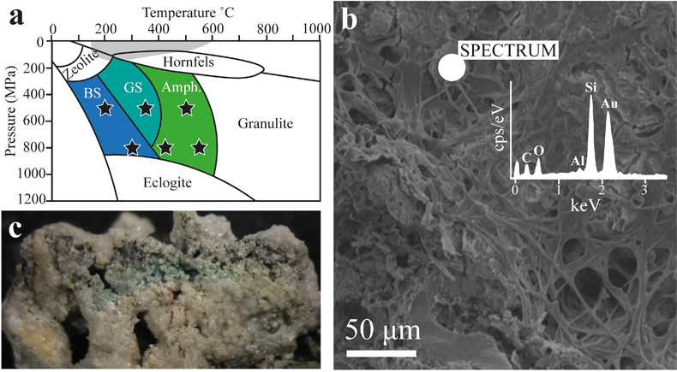
Cousins et al.
Metamorphic evolution of carbonate-hosted microbial biosignatures
Figure 1 Starting material for experiments showing (a) Six high pressure, high temperature (HPHT) experimental conditions investigated and their corresponding metamorphic grades spanning lower and upper blueschist (BS), greenschist (GS) and amphibolite (Amph.). Grey depicts HPHT conditions investigated previously (Schiffbauer et al., 2012; Li et al., 2013b, 2014; Picard et al., 2015a,b; Alleon et al., 2016, 2017; Miot et al., 2017). (b) Si-rich microbial filamentous material and coccoidal cell structures are observed under SEM in the the starting material, shown in (c) by a view ~ 1 cm across; forming Si-rich biofilms around calcite grains (Fig. S-1a,b).
© 2020 The Authors
Published by the European Association of Geochemistry
under Creative Commons License CC BY-NC-ND.
Cousins et al. (2019) Geochem. Persp. Let. 12, 40-45 | doi: 10.7185/geochemlet.2002
Notes:
Figure 1 Starting material for experiments showing (a) Six high pressure, high temperature (HPHT) experimental conditions investigated and their corresponding metamorphic grades spanning lower and upper blueschist (BS), greenschist (GS) and amphibolite (Amph.). Grey depicts HPHT conditions investigated previously (Schiffbauer et al., 2012; Li et al., 2013b, 2014; Picard et al., 2015a,b; Alleon et al., 2016, 2017; Miot et al., 2017). (b) Si-rich microbial filamentous material and coccoidal cell structures are observed under SEM in the the starting material, shown in (c) by a view ~ 1 cm across; forming Si-rich biofilms around calcite grains (Fig. S-1a,b).

