Slide 1
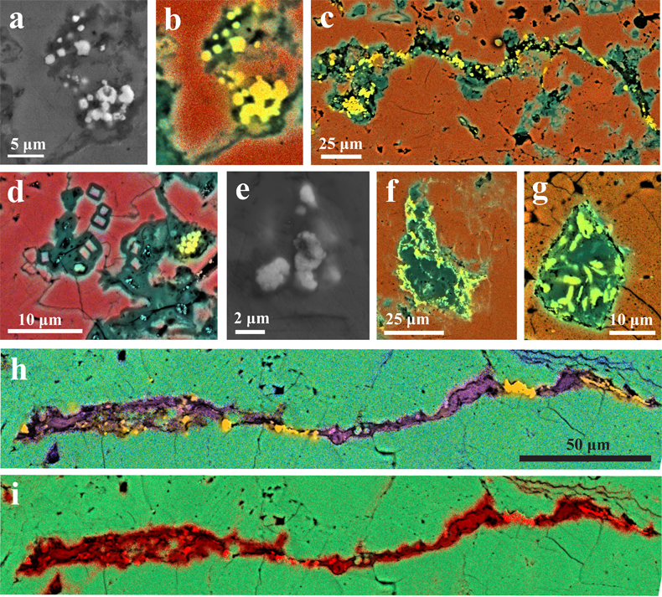
Cousins et al.
Metamorphic evolution of carbonate-hosted microbial biosignatures
Figure 4 (a – g) BSE+EDS elemental maps (red = Ca, green = Si, yellow = S) and SEM images of sulfur globules in (a, b) Starting material; (c) 800 MPa, 425 °C; (d, e) 800 MPa, 300 °C; (f) 800 MPa, 550 °C; and (g) 500 MPa, 500 °C; (h) BSE+EDS elemental map showing the co-location of Fe (Fe = purple) with S (S = yellow) within a silica-rich (Si = red) fabric (i) in the 800 MPa, 425 °C experiment.
© 2020 The Authors
Published by the European Association of Geochemistry
under Creative Commons License CC BY-NC-ND.
Cousins et al. (2019) Geochem. Persp. Let. 12, 40-45 | doi: 10.7185/geochemlet.2002
Notes:
Figure 4 (a – g) BSE+EDS elemental maps (red = Ca, green = Si, yellow = S) and SEM images of sulfur globules in (a, b) Starting material; (c) 800 MPa, 425 °C; (d, e) 800 MPa, 300 °C; (f) 800 MPa, 550 °C; and (g) 500 MPa, 500 °C; (h) BSE+EDS elemental map showing the co-location of Fe (Fe = purple) with S (S = yellow) within a silica-rich (Si = red) fabric (i) in the 800 MPa, 425 °C experiment.

