Slide 1
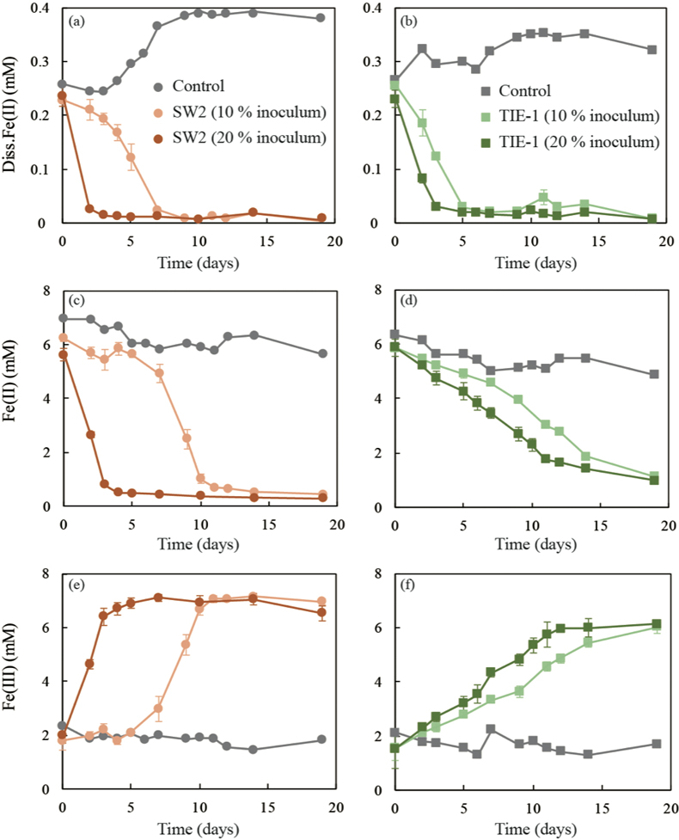
Han et al.
Oxidation of green rust by anoxygenic phototrophic Fe(II)-oxidising bacteria
Figure 2 (a,b) Dissolved Fe(II), (c,d) Fe(II) in solid phase, (e,f) Fe(III) in solid phase at different time points during GR oxidation by SW2 and TIE-1. Error bars indicate standard deviation of three biological replicates.
© 2020 The Authors
Published by the European Association of Geochemistry
under Creative Commons License CC BY-NC-ND.
Han et al. (2020) Geochem. Persp. Let. 12, 52-57 | doi: 10.7185/geochemlet.2004
Notes:
Figure 2 (a,b) Dissolved Fe(II), (c,d) Fe(II) in solid phase, (e,f) Fe(III) in solid phase at different time points during GR oxidation by SW2 and TIE-1. Error bars indicate standard deviation of three biological replicates.

