Slide 1
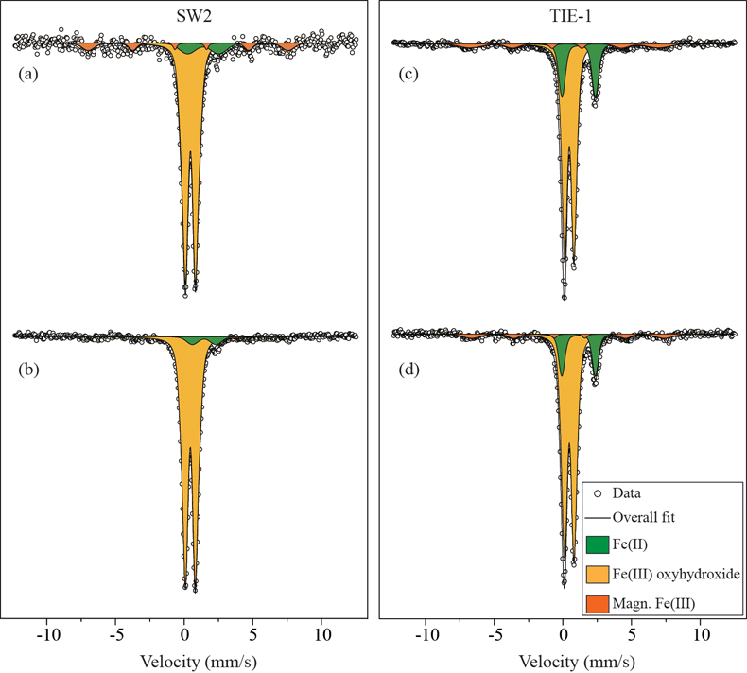
Han et al.
Oxidation of green rust by anoxygenic phototrophic Fe(II)-oxidising bacteria
Figure 3 Mössbauer spectroscopy data of the minerals produced by oxidation of GR by the phototrophic Fe(II)-oxidising strains SW2 (10 % inoculum (a) and 20 % inoculum (b)) and TIE-1 (10 % inoculum (c) and 20 % inoculum (d)), respectively. Magn. Fe(III) corresponds to a magnetically ordered Fe mineral.
© 2020 The Authors
Published by the European Association of Geochemistry
under Creative Commons License CC BY-NC-ND.
Han et al. (2020) Geochem. Persp. Let. 12, 52-57 | doi: 10.7185/geochemlet.2004
Notes:
Figure 3 Mössbauer spectroscopy data of the minerals produced by oxidation of GR by the phototrophic Fe(II)-oxidising strains SW2 (10 % inoculum (a) and 20 % inoculum (b)) and TIE-1 (10 % inoculum (c) and 20 % inoculum (d)), respectively. Magn. Fe(III) corresponds to a magnetically ordered Fe mineral.

