Slide 1
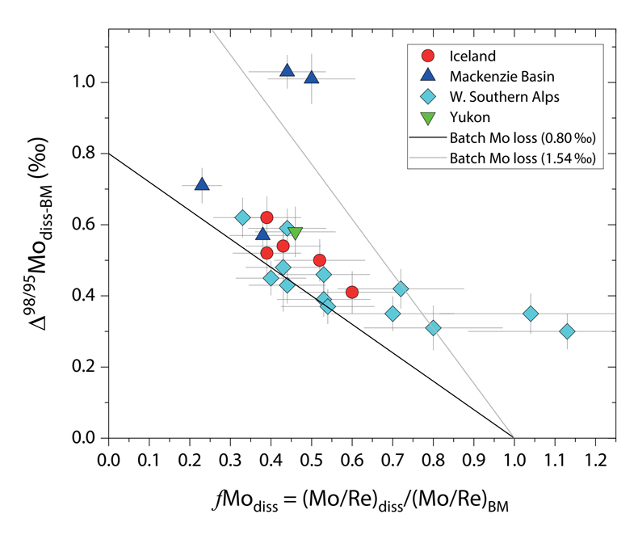
Horan et al.
Unravelling the controls on the molybdenum isotope ratios of river waters
Figure 3 The fraction of Mo remaining in river water, fMo_{diss}, estimated using the ratio of Mo to rhenium (Re) in the dissolved load relative to parent materials, versus the difference in δ^{98/95}Mo between river water and river bed materials. Lines are a batch fractionation model using fractionation factors between a solution and secondary mineral phases, based on fractionation factors of -0.8 ‰ (black) to -1.4 ‰ (grey) (Goldberg et al., 2009; Barling and Anbar, 2004). Error bars indicated for fMo_{diss} are the propagated 2 s.e. errors on (Mo/Re)_{BM}, which is the main source of uncertainty. Error bars for Δ^{98/95}Mo_{diss-BM} incorporate the 2 s.d analytical error on δ^{98/95}Mo_{diss} and the 2 s.e. of the mean δ^{98/95}Mo_{BM}.
© 2020 The Authors
Published by the European Association of Geochemistry
under Creative Commons License CC BY 4.0.
Horan et al. (2020) Geochem. Persp. Let. 13, 1-6 | doi: 10.7185/geochemlet.2005
Notes:
Figure 3 The fraction of Mo remaining in river water, fMo_{diss}, estimated using the ratio of Mo to rhenium (Re) in the dissolved load relative to parent materials, versus the difference in δ^{98/95}Mo between river water and river bed materials. Lines are a batch fractionation model using fractionation factors between a solution and secondary mineral phases, based on fractionation factors of -0.8 ‰ (black) to -1.4 ‰ (grey) (Goldberg et al., 2009; Barling and Anbar, 2004). Error bars indicated for fMo_{diss} are the propagated 2 s.e. errors on (Mo/Re)_{BM}, which is the main source of uncertainty. Error bars for Δ^{98/95}Mo_{diss-BM} incorporate the 2 s.d analytical error on δ^{98/95}Mo_{diss} and the 2 s.e. of the mean δ^{98/95}Mo_{BM}.

