Slide 1
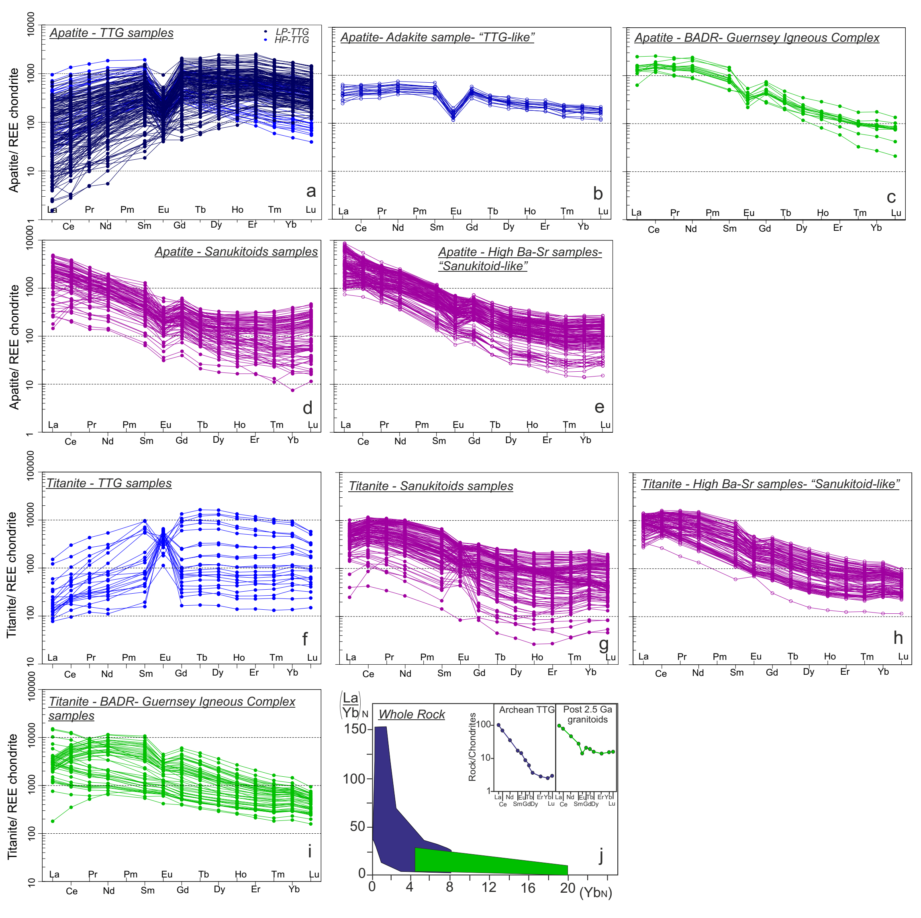
Bruand et al.
Accessory mineral constraints on crustal evolution: elemental fingerprints for magma discrimination
Figure 2 Chondrite normalised REE patterns for apatite (a-e) and titanite (f-i). Diagram j represents La/Yb vs. Yb values normalised to chondrite for whole rock data, modified after Moyen and Martin (2012). Green and blue fields correspond to post 2.5 Ga granitoids and TTG, respectively.
© 2020 The Authors
Published by the European Association of Geochemistry
under Creative Commons License CC BY-NC-ND.
Bruand et al. (2020) Geochem. Persp. Let. 13, 7-12 | doi: 10.7185/geochemlet.2006
Notes:
Figure 2 Chondrite normalised REE patterns for apatite (a-e) and titanite (f-i). Diagram j represents La/Yb vs. Yb values normalised to chondrite for whole rock data, modified after Moyen and Martin (2012). Green and blue fields correspond to post 2.5 Ga granitoids and TTG, respectively.

