Slide 1
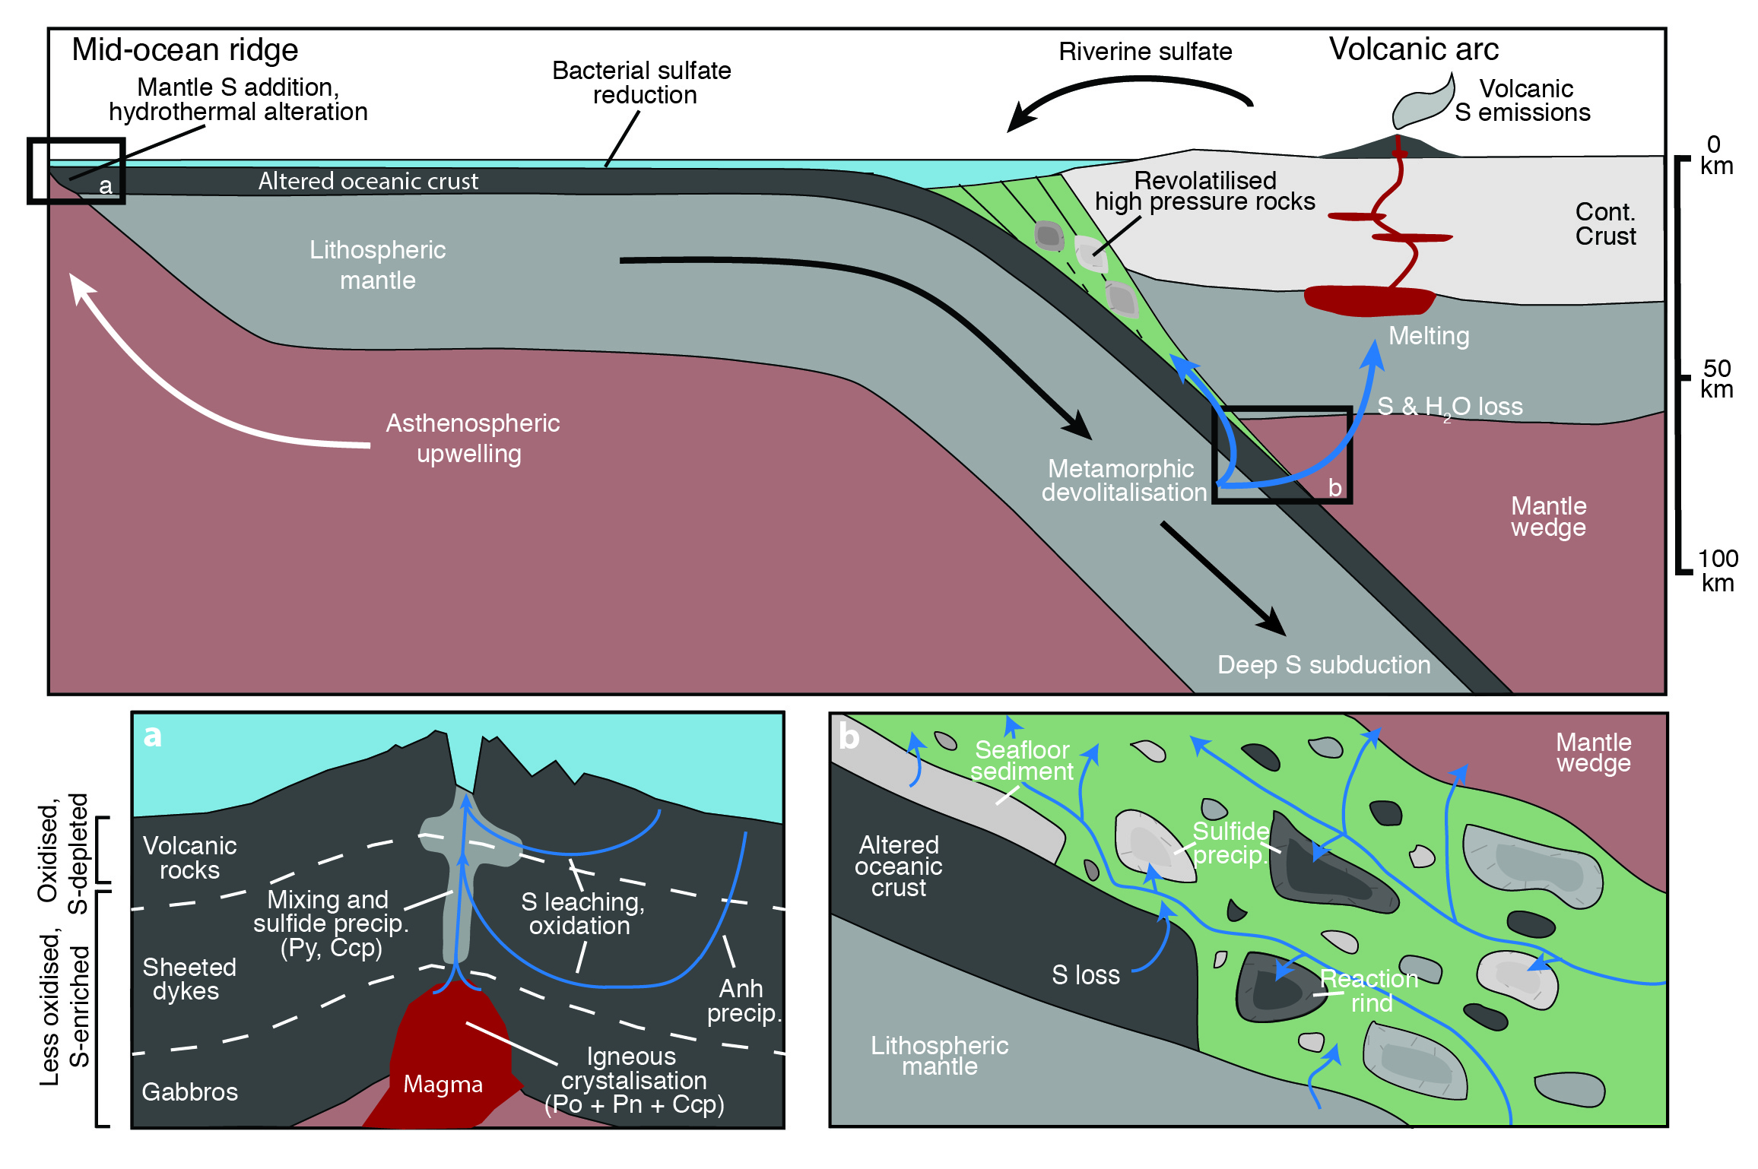
Walters et al.
Sulfur loss from subducted altered oceanic crust and implications for mantle oxidation
Figure 1 Schematic diagram showing the broader subduction zone system. Sulfur is introduced to the oceanic crust during crystallisation and hydrothermal circulation. (a) Magmatic sulfides react to form pyrite ± chalcopyrite and iron is oxidised (see Supplementary Information S-1). Sulfur is later extracted during metamorphic devolatilisation. (b) Sulfides precipitate in reaction rinds formed upon exhumation of metamorphic rocks along the slab mantle interface, while the remaining sulfur infiltrates the overlying subarc mantle.
© 2020 The Authors
Published by the European Association of Geochemistry
under Creative Commons License CC BY-NC-ND.
Walters et al. (2020) Geochem. Persp. Let. 13, 36-41 | doi: 10.7185/geochemlet.2011
Notes:
Figure 1 Schematic diagram showing the broader subduction zone system. Sulfur is introduced to the oceanic crust during crystallisation and hydrothermal circulation. (a) Magmatic sulfides react to form pyrite ± chalcopyrite and iron is oxidised (see Supplementary Information S-1). Sulfur is later extracted during metamorphic devolatilisation. (b) Sulfides precipitate in reaction rinds formed upon exhumation of metamorphic rocks along the slab mantle interface, while the remaining sulfur infiltrates the overlying subarc mantle.

