Slide 1
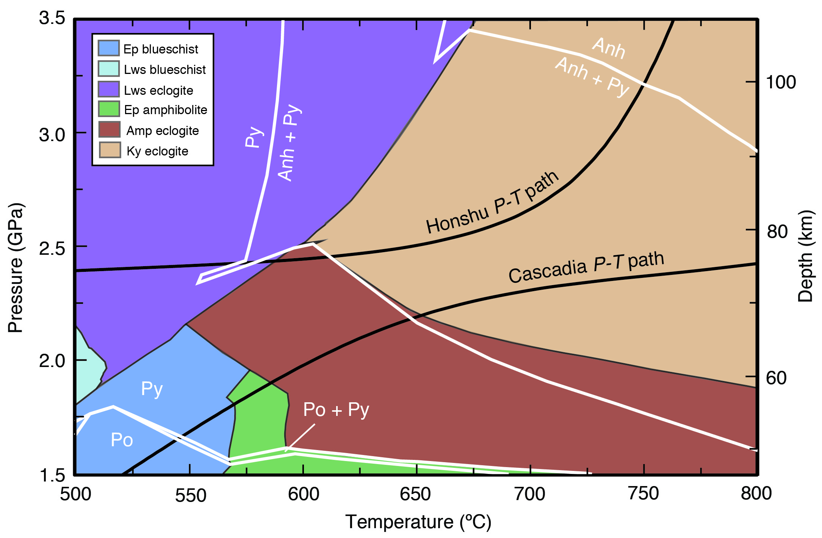
Walters et al.
Sulfur loss from subducted altered oceanic crust and implications for mantle oxidation
Figure 2 Closed system phase equilibrium modelling results utilising an average AOC composition from ODP hole 504B. The stability fields of common rock types are shaded (see key) and the stable solid sulfur phases are also highlighted. Honshu and Cascadia slab top P-T paths after Syracuse et al. (2010).
© 2020 The Authors
Published by the European Association of Geochemistry
under Creative Commons License CC BY-NC-ND.
Walters et al. (2020) Geochem. Persp. Let. 13, 36-41 | doi: 10.7185/geochemlet.2011
Notes:
Figure 2 Closed system phase equilibrium modelling results utilising an average AOC composition from ODP hole 504B. The stability fields of common rock types are shaded (see key) and the stable solid sulfur phases are also highlighted. Honshu and Cascadia slab top P-T paths after Syracuse et al. (2010).

