Slide 1
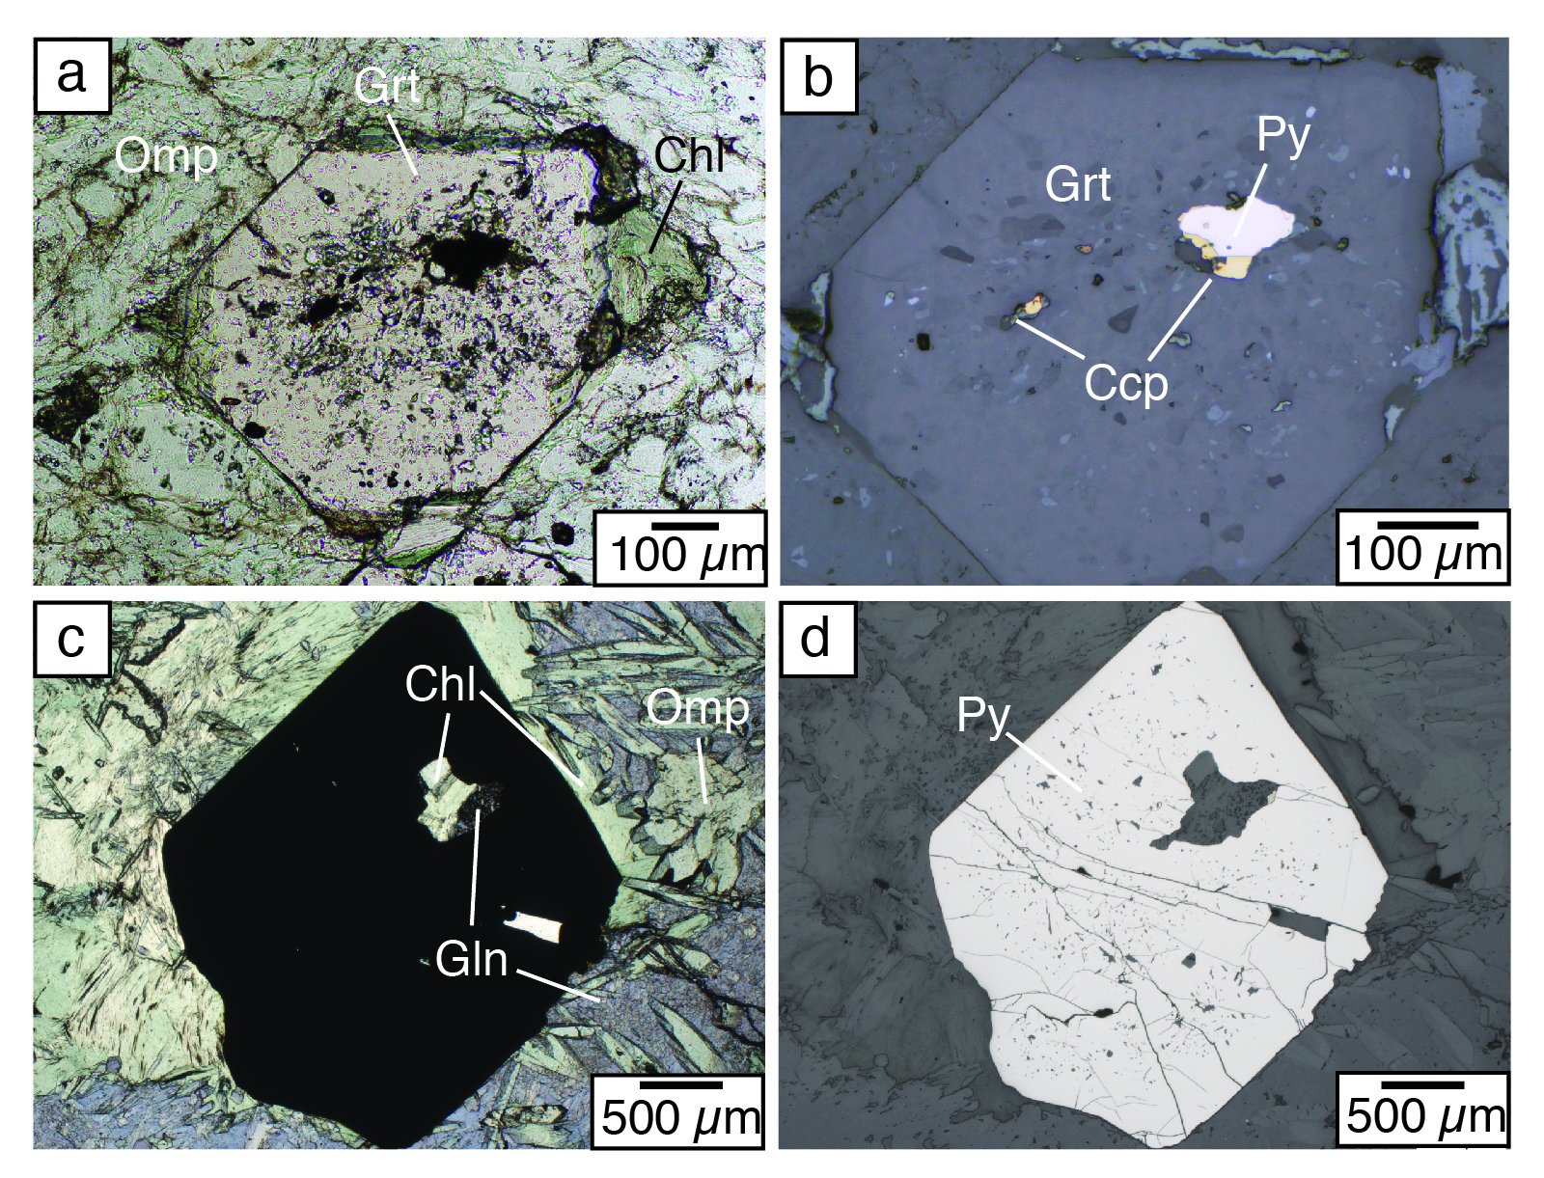
Walters et al.
Sulfur loss from subducted altered oceanic crust and implications for mantle oxidation
Figure 4 Transmitted (a,c) and reflected (b,d) light images of sulfides in eclogites. In (a,b), pyrite + chalcopyrite are observed as inclusions in garnet from the Junction School eclogite, Franciscan Complex, California. In (c,d), matrix pyrite is associated with retrograde chlorite + glaucophane in a metasomatised metagabbroic eclogite from Syros, Greece.
© 2020 The Authors
Published by the European Association of Geochemistry
under Creative Commons License CC BY-NC-ND.
Walters et al. (2020) Geochem. Persp. Let. 13, 36-41 | doi: 10.7185/geochemlet.2011
Notes:
Figure 4 Transmitted (a,c) and reflected (b,d) light images of sulfides in eclogites. In (a,b), pyrite + chalcopyrite are observed as inclusions in garnet from the Junction School eclogite, Franciscan Complex, California. In (c,d), matrix pyrite is associated with retrograde chlorite + glaucophane in a metasomatised metagabbroic eclogite from Syros, Greece.

