Slide 1
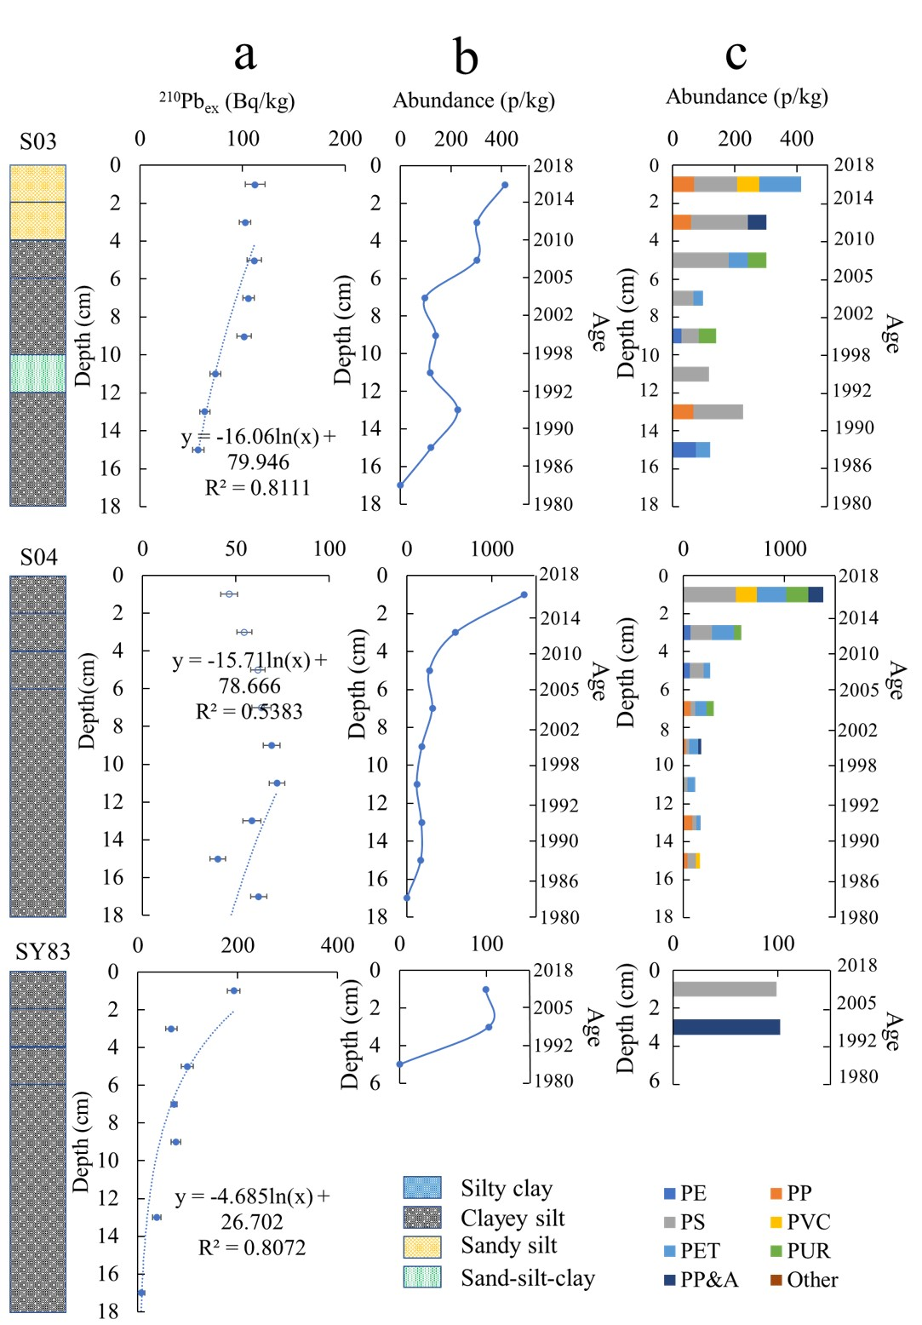
Chen et al.
Forty-year pollution history of microplastics in the largest marginal sea of the western Pacific
Figure 1 The profiles of excess ²¹⁰Pb, microplastic abundance and microplastic composition of sediment cores at S03, S04, and SY83 stations (the profiles of sediment cores at SY81, SY87, and SQW43 stations are shown in Fig. S-1). (a) Excess ²¹⁰Pb profile. The sediment rates were calculated according to the gradient of the excess ²¹⁰Pb as a function of the depth. (b) Microplastic abundance (pieces per kg dry weight). (c) Microplastic composition. PE-polyethylene, PP-polypropylene, PS-polystyrene, PVC-polyvinyl chloride, PET-polyethylene terephthalate, PUR-polyurethane, PP&A includes polyester, polyamide, rayon and acrylic.
© 2020 The Authors
Published by the European Association of Geochemistry
under Creative Commons License CC BY-NC-ND.
Chen et al. (2020) Geochem. Persp. Let. 13, 42-47 | doi: 10.7185/geochemlet.2012
Notes:
Figure 1 The profiles of excess ²¹⁰Pb, microplastic abundance and microplastic composition of sediment cores at S03, S04, and SY83 stations (the profiles of sediment cores at SY81, SY87, and SQW43 stations are shown in Fig. S-1). (a) Excess ²¹⁰Pb profile. The sediment rates were calculated according to the gradient of the excess ²¹⁰Pb as a function of the depth. (b) Microplastic abundance (pieces per kg dry weight). (c) Microplastic composition. PE-polyethylene, PP-polypropylene, PS-polystyrene, PVC-polyvinyl chloride, PET-polyethylene terephthalate, PUR-polyurethane, PP&A includes polyester, polyamide, rayon and acrylic.

