Slide 1
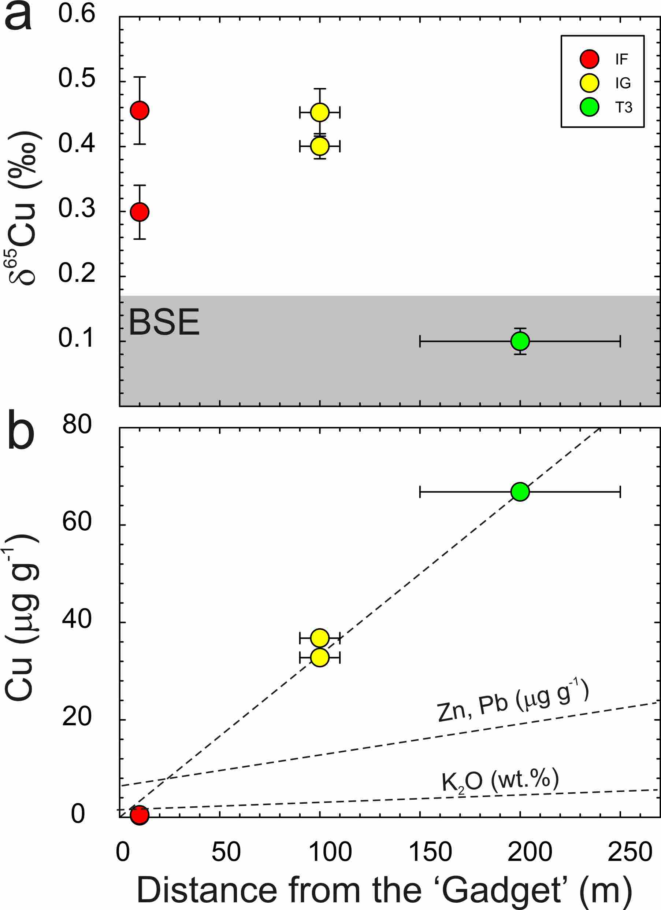
Day et al.
Moderately volatile element behaviour at high temperature determined from nuclear detonation
Figure 2 (a) δ⁶⁵Cu and (b) Cu abundance in trinitite with distance from the ‘Gadget’ compared with Zn, Pb and K contents from the same samples (Day et al., 2017; Chen et al., 2019). BSE is from Savage et al. (2015).
© 2020 The Authors
Published by the European Association of Geochemistry
under Creative Commons License CC BY-NC-ND.
Day et al. (2020) Geochem. Persp. Let. 13, 54-60 | doi: 10.7185/geochemlet.2014
Notes:
Figure 2 (a) δ⁶⁵Cu and (b) Cu abundance in trinitite with distance from the ‘Gadget’ compared with Zn, Pb and K contents from the same samples (Day et al., 2017; Chen et al., 2019). BSE is from Savage et al. (2015).

