Slide 1
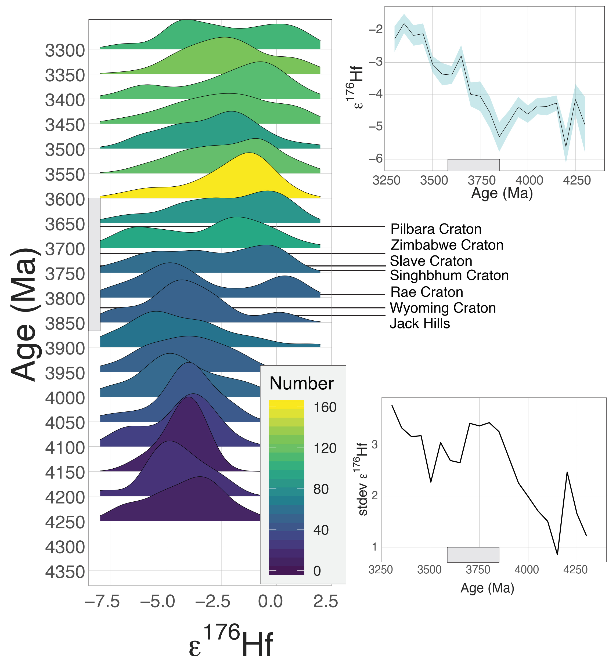
Bauer and Reimink et al.
Hafnium isotopes in zircons document the gradual onset of mobile-lid tectonics
Figure 2 Stacked probability density plot of the global zircon age-ε_{Hf} compilation, with 50 Myr age bins. Colours indicate n for each bin. The timing of change-point shifts for cratons are labeled. The upper inset shows the moving average and 2 s.e. within this population; the lower shows the moving standard deviation.
© 2020 The Authors
Published by the European Association of Geochemistry
under Creative Commons License CC BY-NC-ND.
Bauer and Reimink et al. (2020) Geochem. Persp. Let. 14, 1-6 | doi: 10.7185/geochemlet.2015
Notes:
Figure 2 Stacked probability density plot of the global zircon age-ε_{Hf} compilation, with 50 Myr age bins. Colours indicate n for each bin. The timing of change-point shifts for cratons are labeled. The upper inset shows the moving average and 2 s.e. within this population; the lower shows the moving standard deviation.

